Slide 1

INNOVATION AND DESIGN

Slide 2

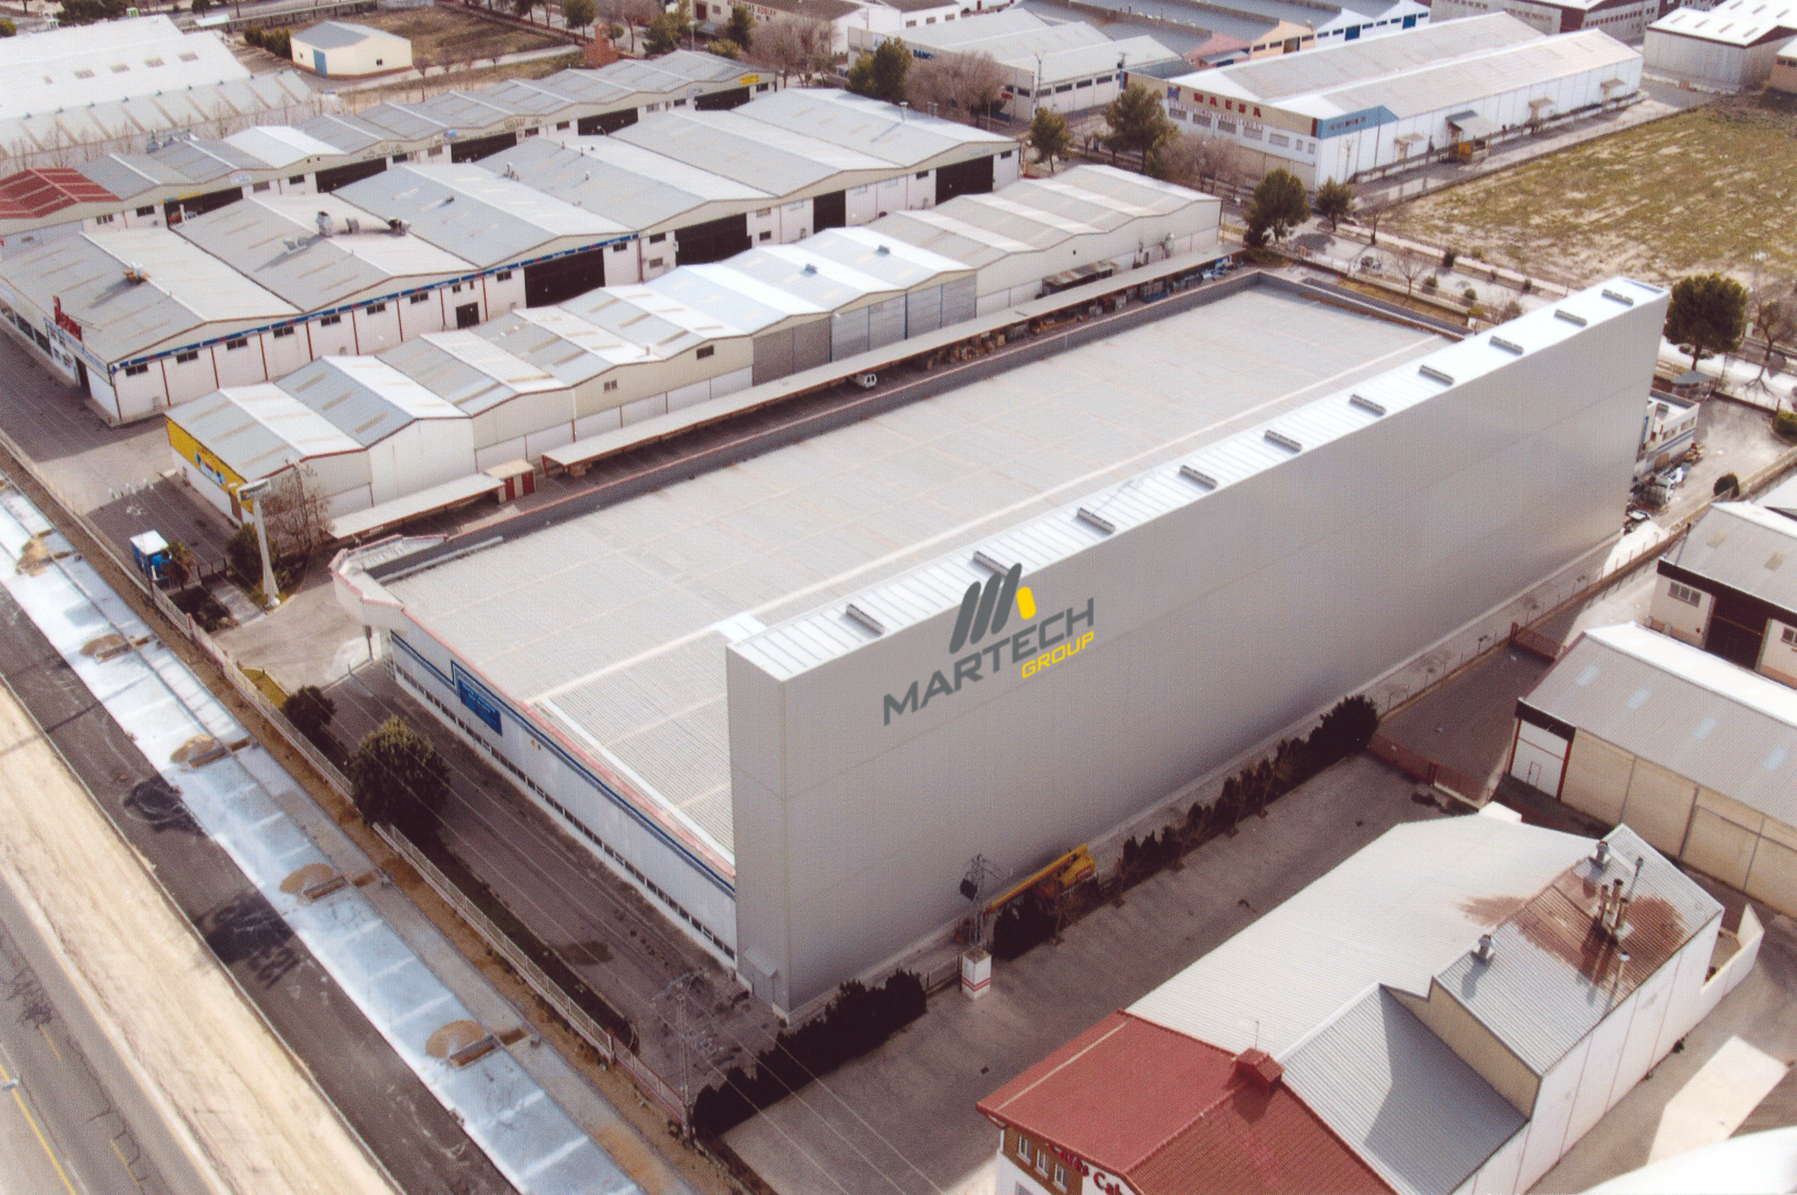
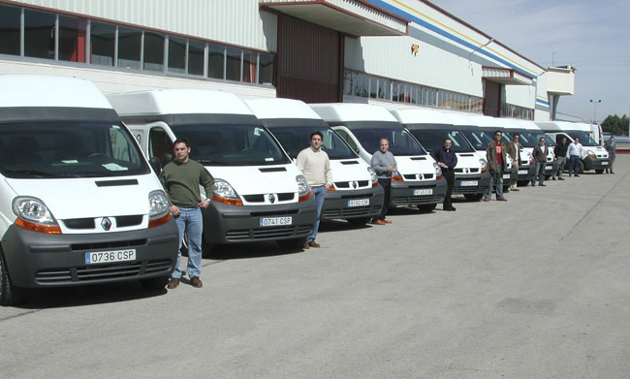
ABOUT US
VALUES:
More than 25 years dedication to the sector of the production of equipment for automotive and industry.
At the end of the 80s, Juan Antonio and Jose Ramón Martínez started in the world of repair, to the commercialization of equipment throughout the Spanish geography. Later on, they made the decision to manufacture paint booths, expanding their operations to the international market..
At the beginning of the 90s, they had a very clear VISION of the company: “any repair and painting center that decides to buy or update tools or equipment, think of us”. They create a MISSION: to have a catalog under the same brand with which to equip any workshop with equipment or tools, creating a slogan "turnkey repair". Then the leap to all of Latin America is made.
EIn 2011: with a lot of experience and knowledge acquired in the area of ​​surface finishing. Martech Corporation is created, a new brand with the most advanced technology on the market, covering the broader sectors of the industry that require a painting process

Slide 3
BUSINESS GROUP
ACTIVITY SECTORS:
The founders of Martech Corporation, leads them to take initiatives in different sectors of the market, creating a group of companies that act in different fields and sectors, both in the national and international markets.
SPANESI INTERNACIONAL
Market leader as an equipment supplier, with the widest range of equipment in the automotive repair sector, in Spain.
MARTECH CAR
Its activity is focused on internationalization through the network of importers and clients in international markets, through its extensive equipment catalog, for the automotive sector.
MARTECH INDUSTRY
Focused exclusively on designing, projecting, and executing projects in the field of surface treatment and final finishing, for the national and international market in the different sectors of the industry, having as strategic sectors: Railway, Aeronautical, Wind, Wood, Metalworking, etc.
BODYSHOP REPAUT & ALICAR
Repair, testing and process control centers in the automotive sector.
CAR DEALERS
Official dealers of leading brands (BMW, SKODA, RENAULT)
Industry
Automotive
Equipment tools suplier
Consulting in repair processes.

Slide 4


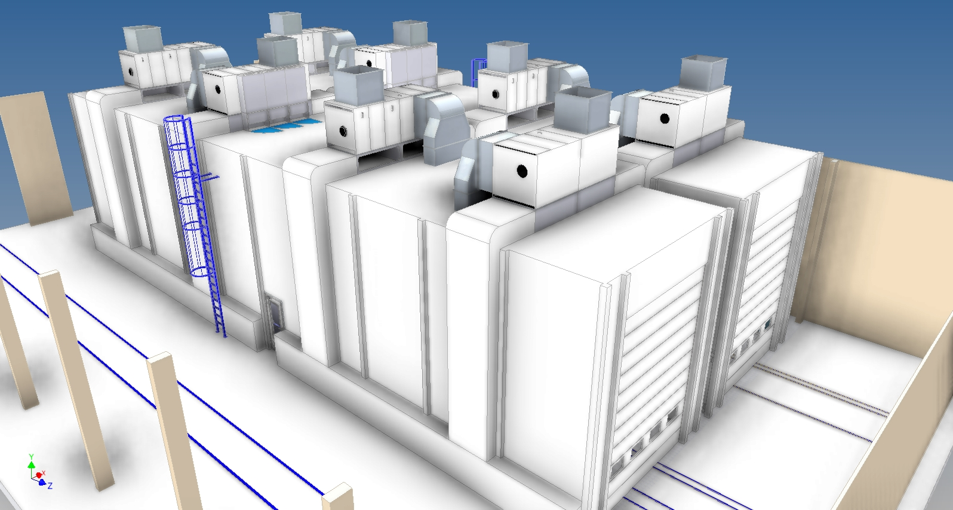
OUR KNOWLEDGE
HUMAN TEAM:
Project
Design
Project execution
After sale
Remote Assistance.
PROJECTS:
At Martech Corporation, we are committed to the implementation of highly productive processes. This supposes the training and provision of the necessary knowledge to carry out a productive, efficient and quality flow. Advice, support and auditing are the key to success.
Commercial Department with extensive knowledge and specialization in the different sectors of activity of the company, with technical capacity, to advise on the best cost-benefit solution for the client.
  DESIGN:
A solvent and highly qualified engineering team in the development of 3D projects, made up of senior engineers, designers and designers. committed to developing solutions that allow to optimize productivity and at the same time are: efficient, adjusted in costs, guarantee profit and meet the real needs of our customers.
  Our Technical Project Office provides a comprehensive service and advice for new assemblies and installations. "Turnkey" with implementation of processes and personalized audits.

Slide 5


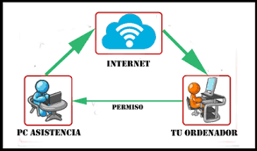
OUR KNOWLEDGE
HUMAN TEAM:
Project
Design
Project execution
After sale
Remote Assistance.
  PROJECT EXECUTION:
  Specialized in managing "turnkey" projects with implementation of processes and personalized audits, simplifying the intervention of a single interlocutor with the client.
  After sale:
  We guarantee local technical assistance, with the presence of our own and qualified technicians throughout the country. Allowing our client the possibility of preventive maintenance contracts, with competitive costs.
  REMOTE ASSISTANCE:
  We make it possible to have remote supervision from our central monitoring any of the installation, being able to issue automatic alerts.

Slide 6
OUR KNOWLEDGE
TECHNOLOGICAL DEVELOPMENT:
Endothermic Panels
Direct burner.
Infrared Systems.
  Endothermic Panels:
  One of the main concerns of the Martech Corporation is the search for new technologies and production processes that allow reducing costs in work processes. This concern and taking advantage of our own repair center, we develop and test new energy efficient systems, which has allowed us to develop systems with greater energy efficiency, such as ENDOTHERMIC PANELS.
  Leaders in the installation of Endothermic Panels,
  More than 1000 executed installations.
  The system allows a reduction in the total work cycle more than 30%.

Slide 7
OUR KNOWLEDGE
TECHNOLOGICAL DEVELOPMENT:
  Direct Burner:
  Developed for large volume paint booths. Its main virtues lie in the wide range of regulation and modulation, taking advantage of 100% of the combustion, avoiding unnecessary losses.
  Martech Corporation installs its own equipment, without dependence on third parties for start-up, which implies a reduction in costs for the customer.
Endothermic Panels.
Direct Burner
Infrared Systems.
  Infrared Systems:
Bridge of I.R. motorized automatic with software that controls power, speed and temperature. With the advantage of manual movement to the starting position.

Slide 8
OUR NUMBERS
6 Training Centers
+ 8000 Instalations executed
1 “Show Room”
2 Bodyshops Centers
Agreements with repair experimentation centers: CESVIMAP, CENTRO ZARAGOZA

Slide 9
OUR NUMBERS
30
YEARS OF EXPERIENCE, as market leaders in the supply of equipment,
for repair.
8000
20
CUSTOMERS, have trusted our products.
COUNTRIES, with a consolidated presence..

Slide 10


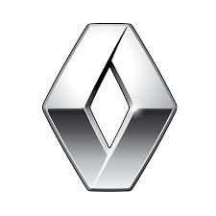
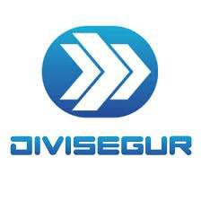


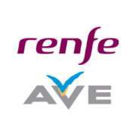




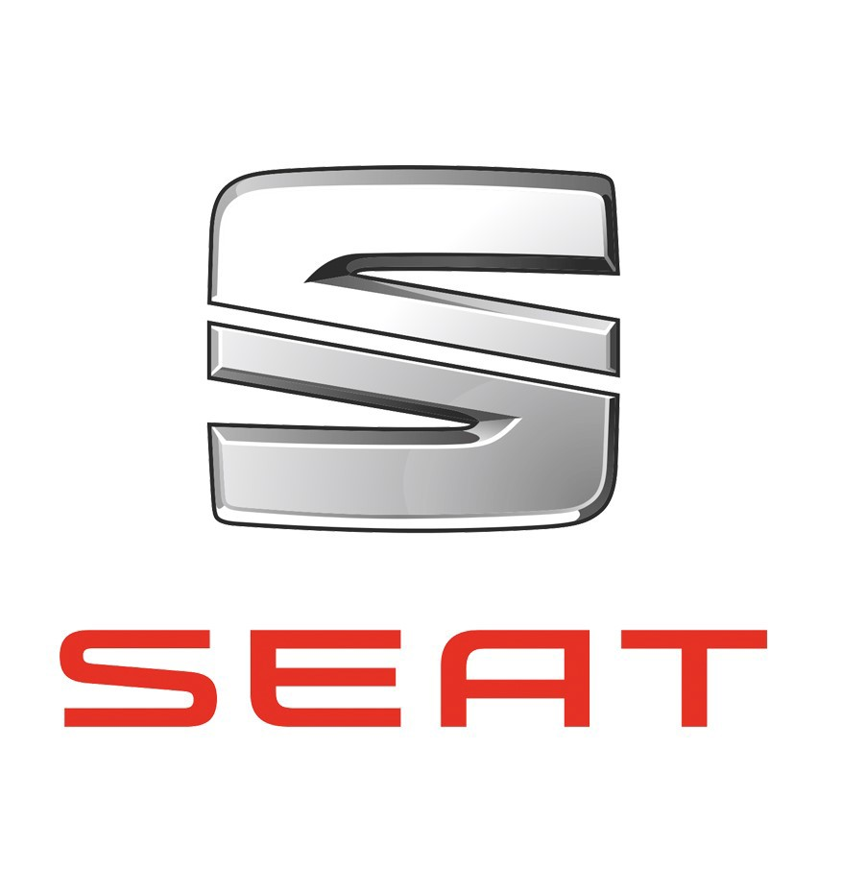

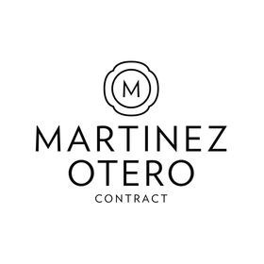



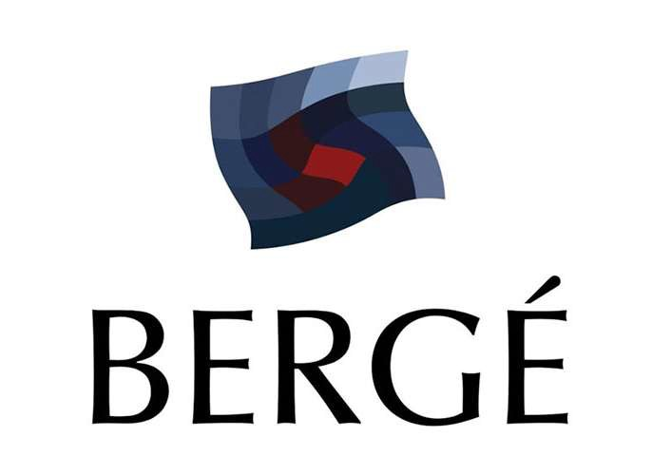

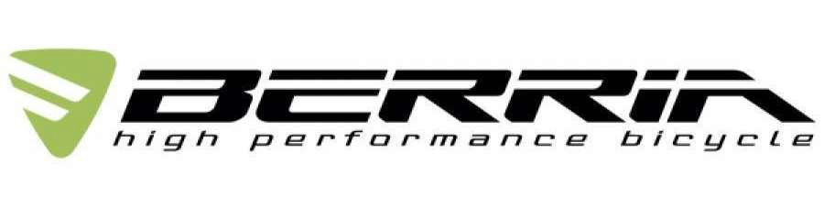

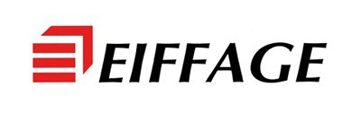









OUR CUSTOMERS
CUSTOMERS AREAS:
Aeronautical
Automobile
Industry
Railway
Aeronautical
Automobile
Industry
Wood Finishing
Metal
Renewable energies
Railway

Slide 11

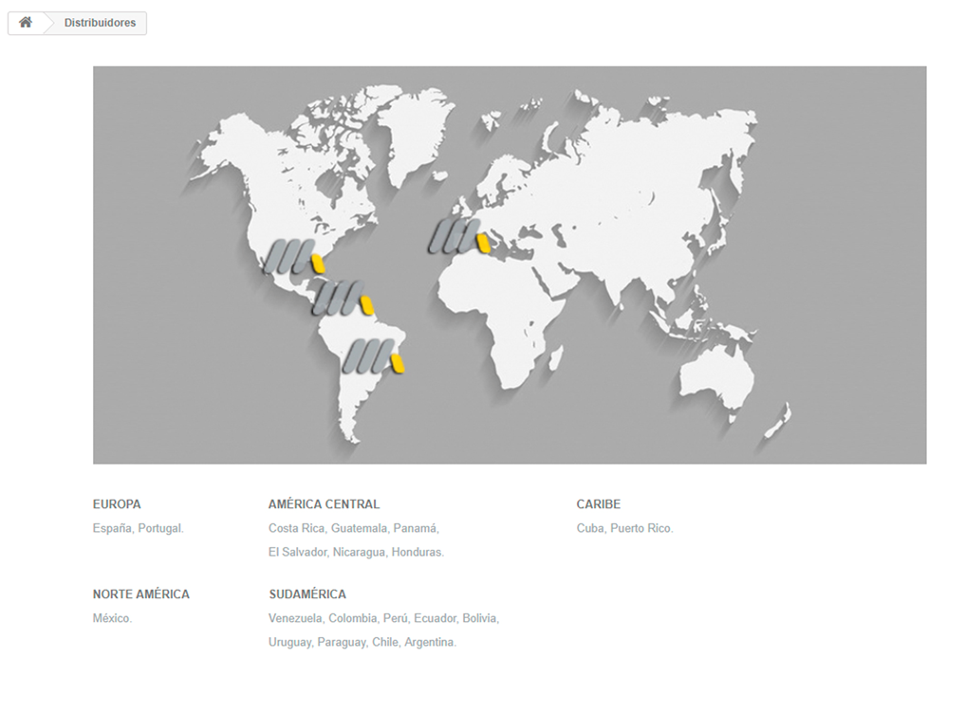
MARTECH CORPORATION IN THE WORLD
DEALERS
INSTALATIONS
Dealers:
Europe
North America
Central America
South America
Caribbean
Instalations:
Angola
Thailand
France
U.K ………….

Slide 12
¿WHY MARTECH CORPORATION?
Company with the best technology and modern equipment on the market, always with the commitment to include the latest new products.
Company recognized worldwide and approved by the main manufacturers..
ISO 9001 quality certified company, to demonstrate the good management carried out in all departments.
Company with the most comlete catalog on the market, capable of supplying 100% of the appropriate equipment and tools in each process and repair area..
Company committed to the environment and the ergonomics of the equipment to facilitate and perform comfortable and efficient work, to achieve the highest quality that customers deserve. Our purpose "finishes as it left the factory".
Experience in developing solutions with a contained cost, with the maximum use of space and balanced in cost / benefit.

Slide 13

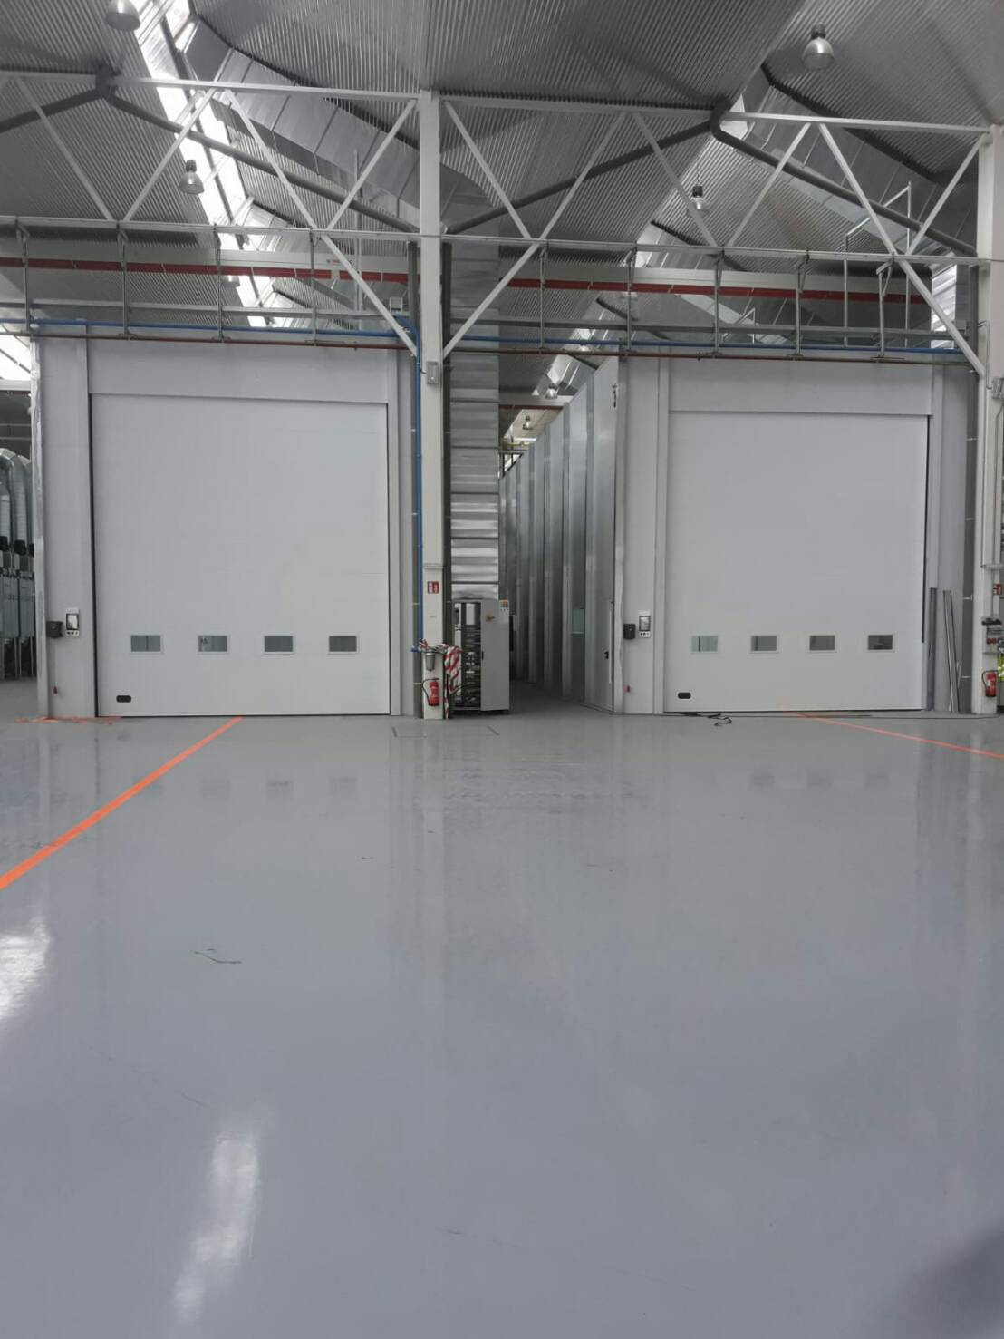
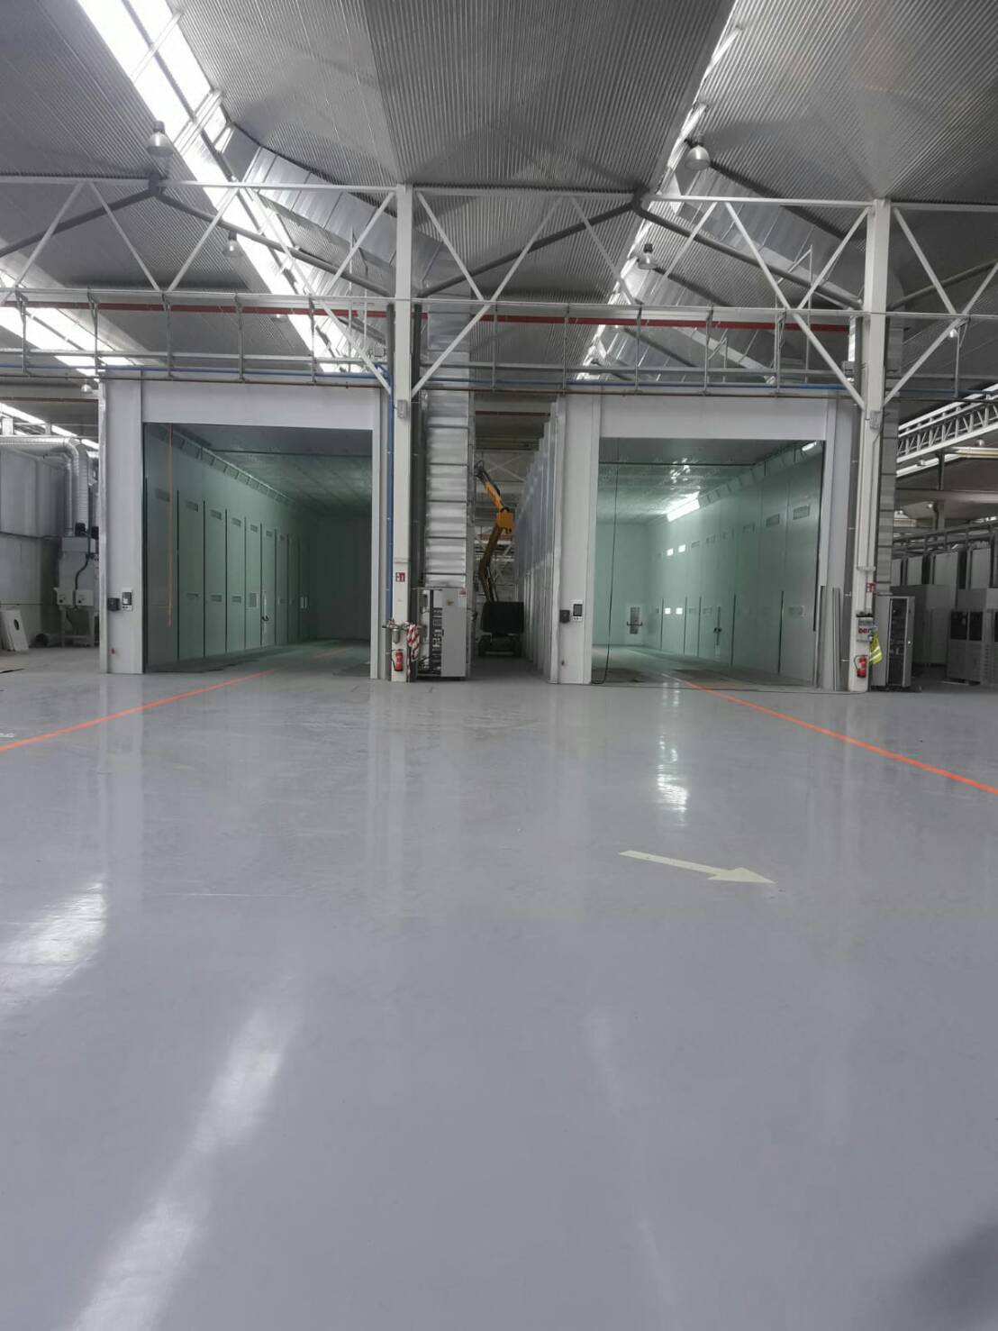
INSTALATIONS
Railway
BMI (Valladolid)
Spray Booth and Preparation area.

Slide 14
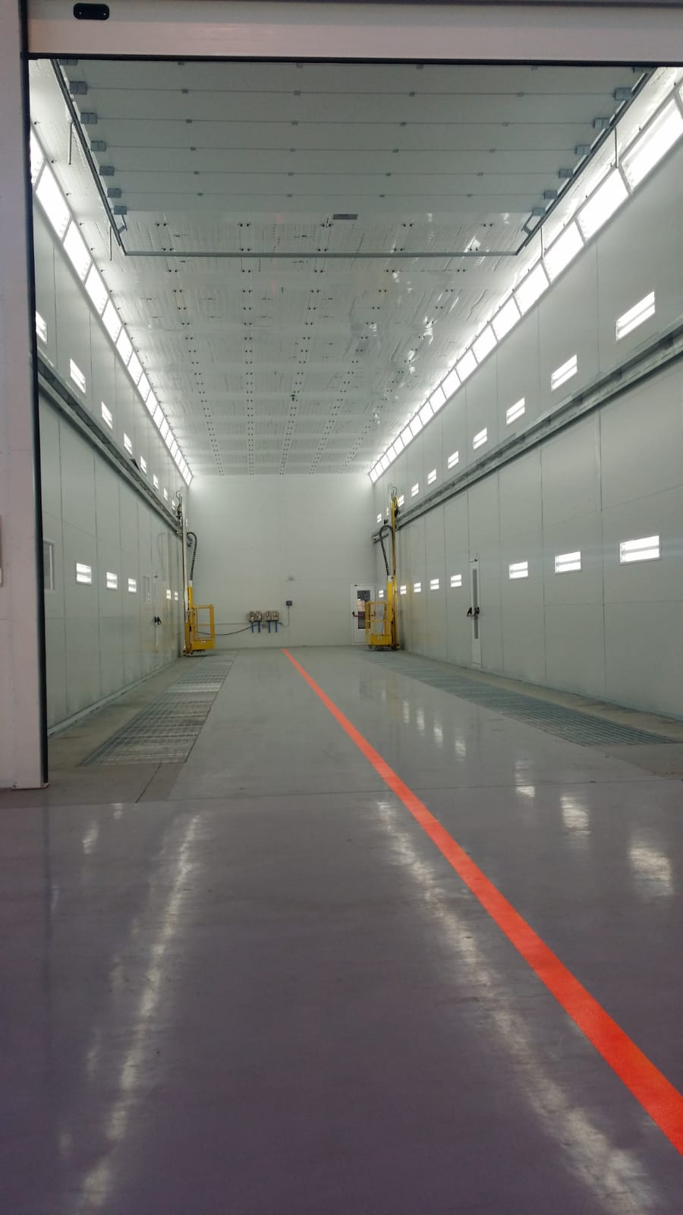
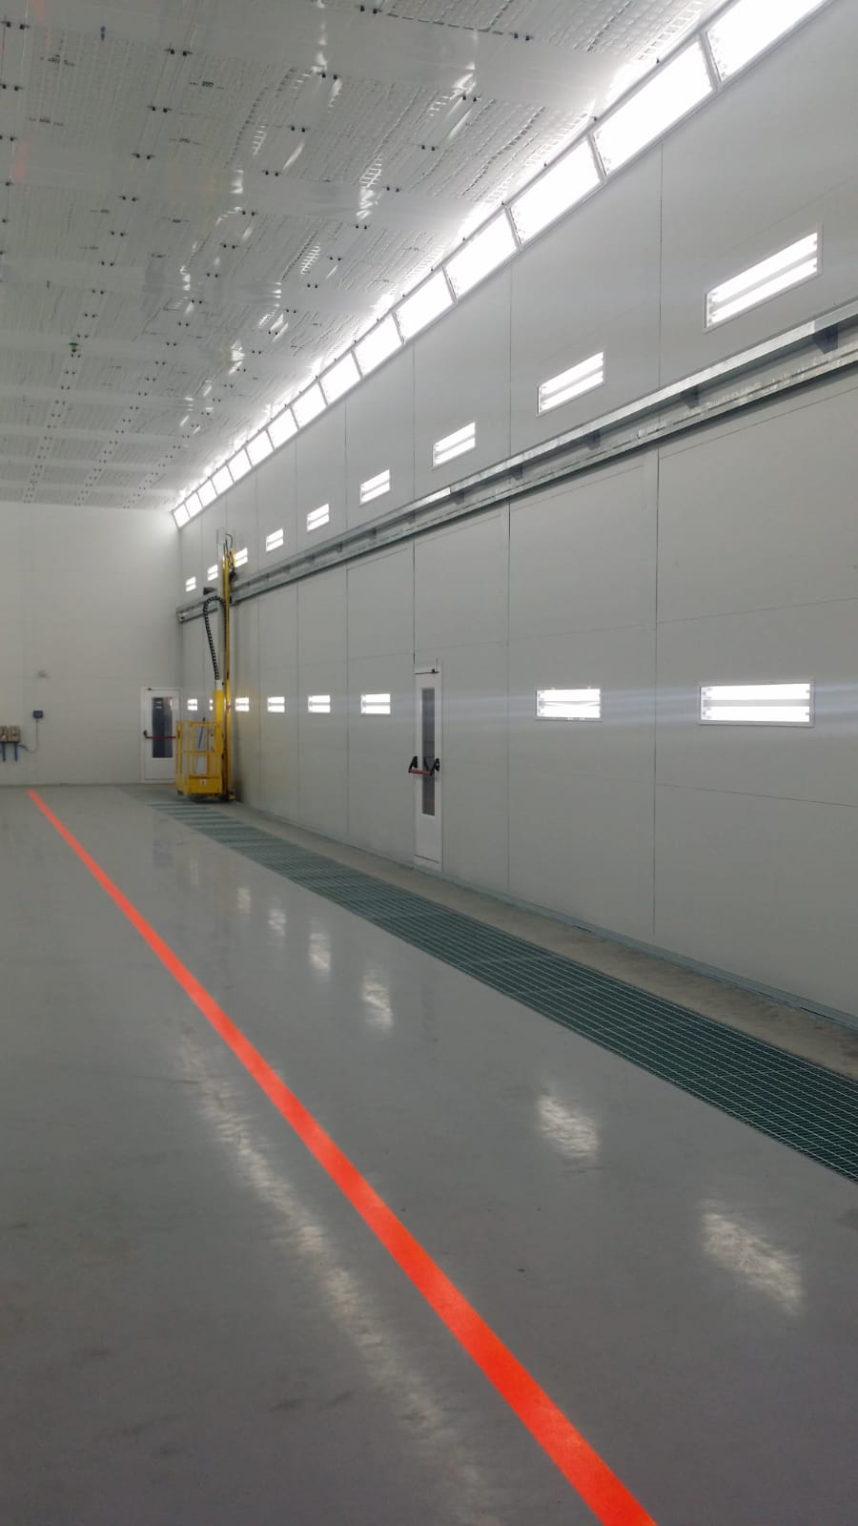
INSTALATIONS
Railway
BMI (Valladolid)
Spray Booth and Preparation area.

Slide 15
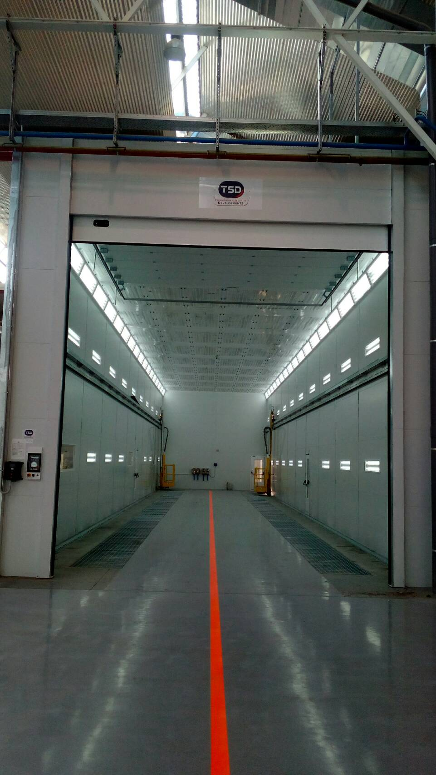
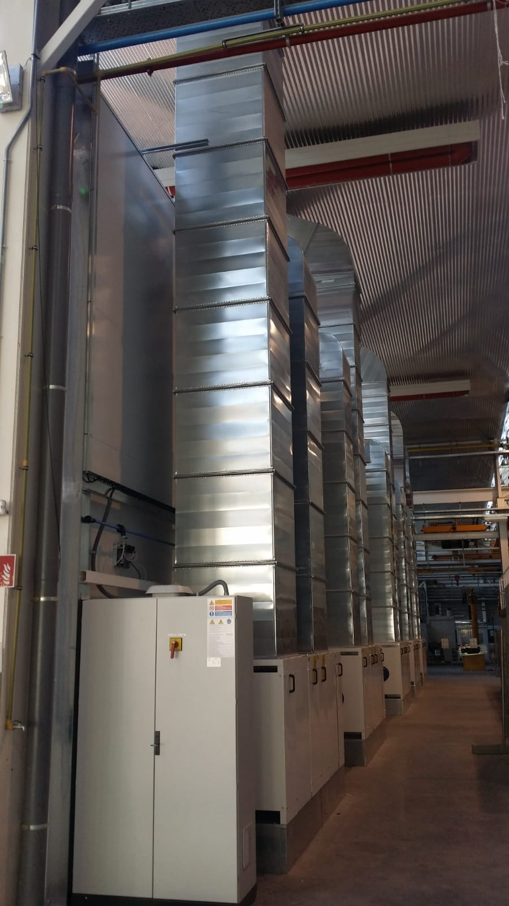
INSTALATIONS
Railway
BMI (Valladolid)
Internal spray booth
Impul- expul generators.

Slide 16
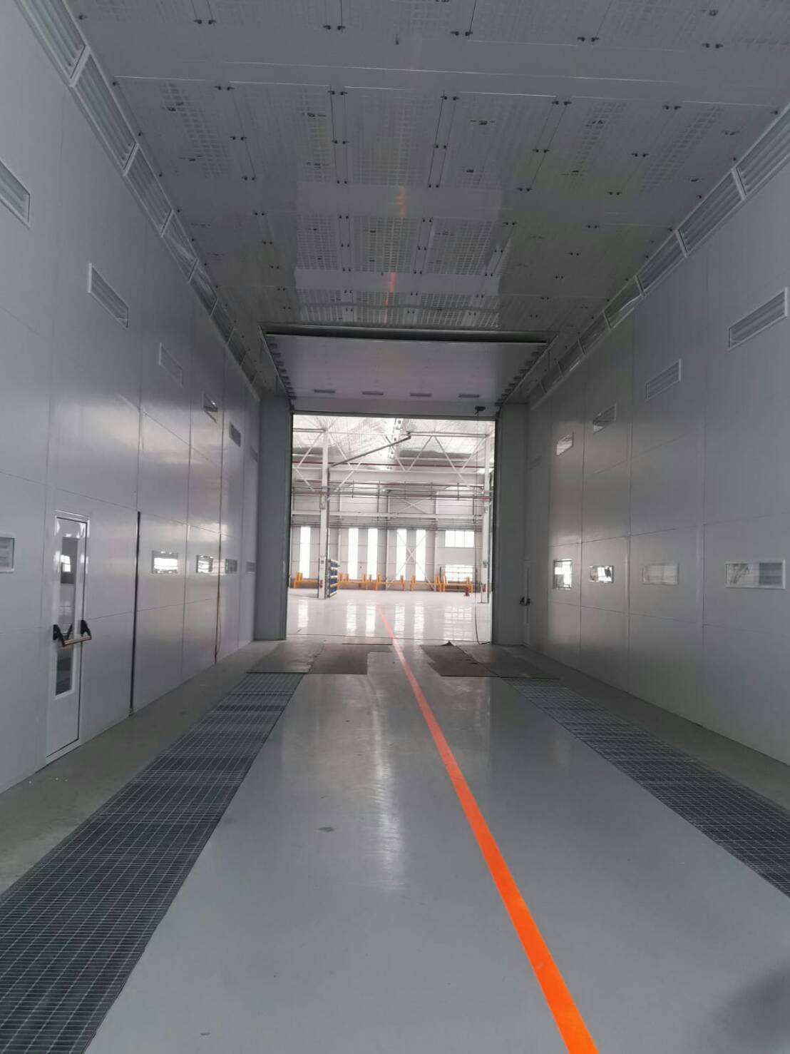
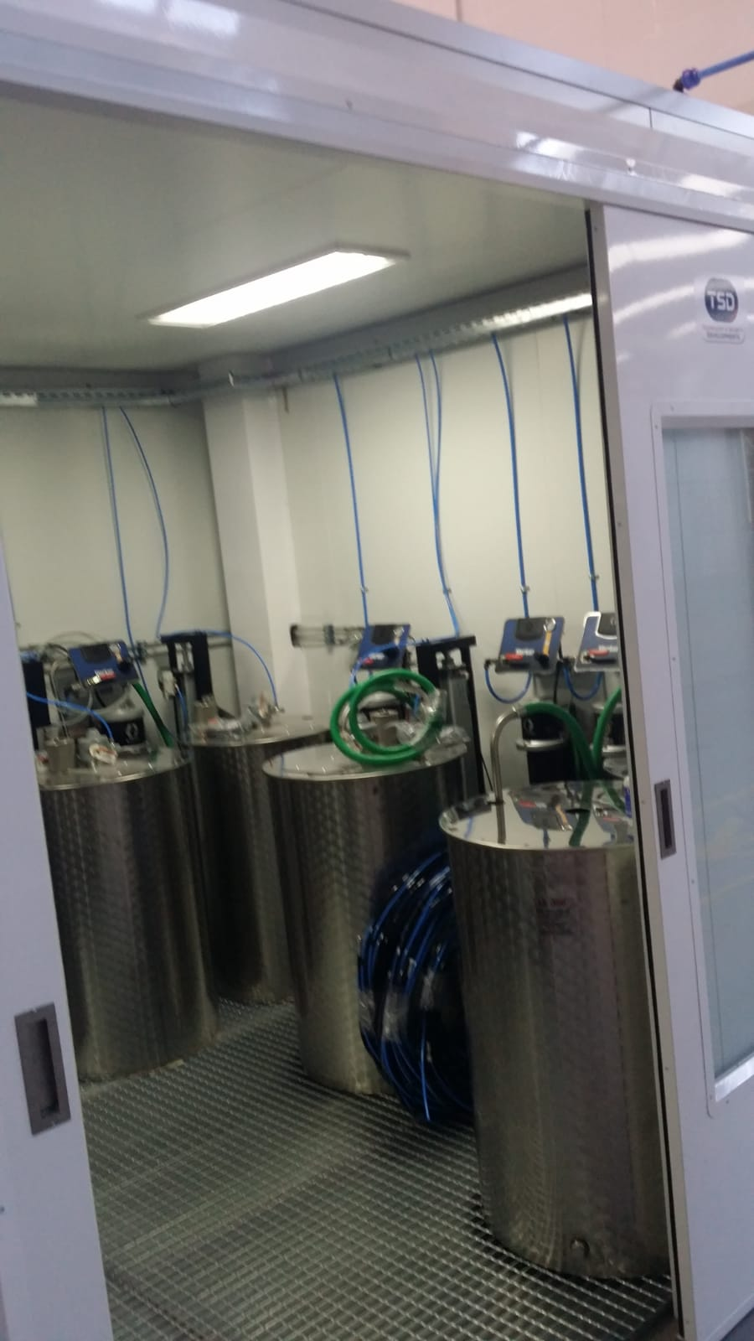
INSTALATIONS
Railway
BMI (Valladolid)
Internal spray booth
Mixing room

Slide 17
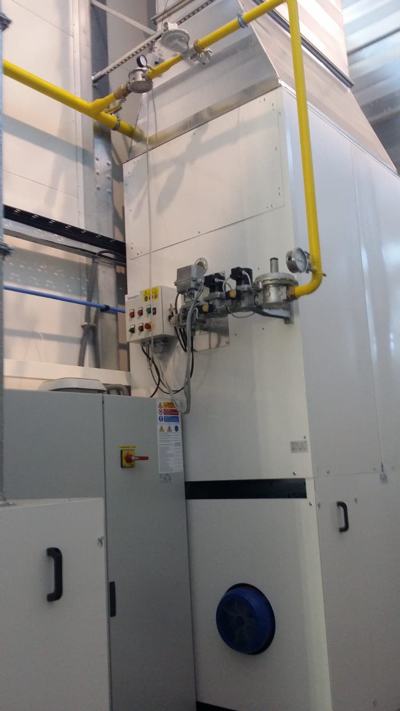
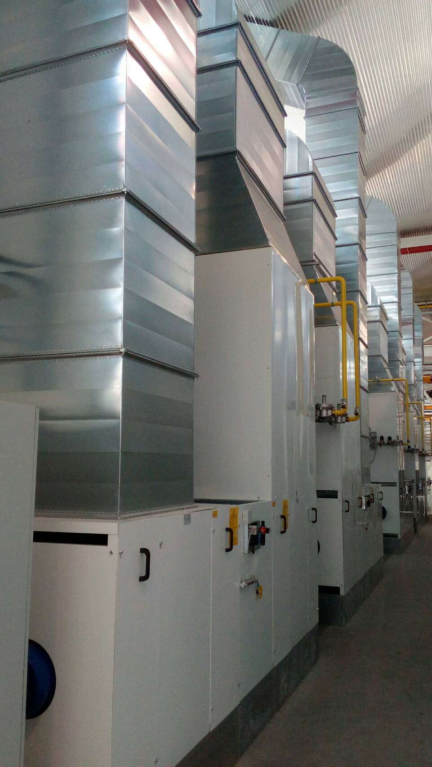
INSTALATIONS
Railway
BMI (Valladolid)
Direct burner flame
Impul – expul generators

Slide 18
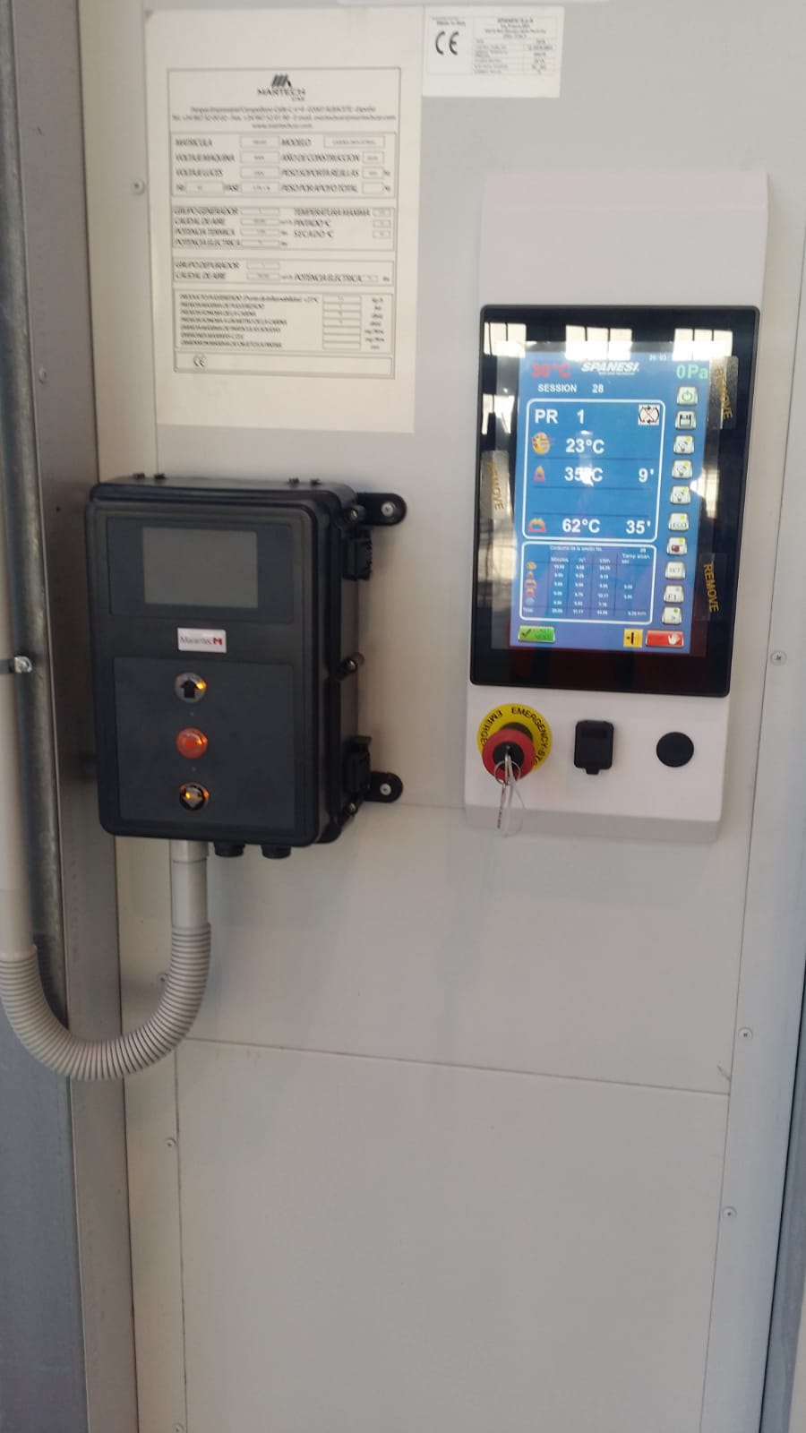
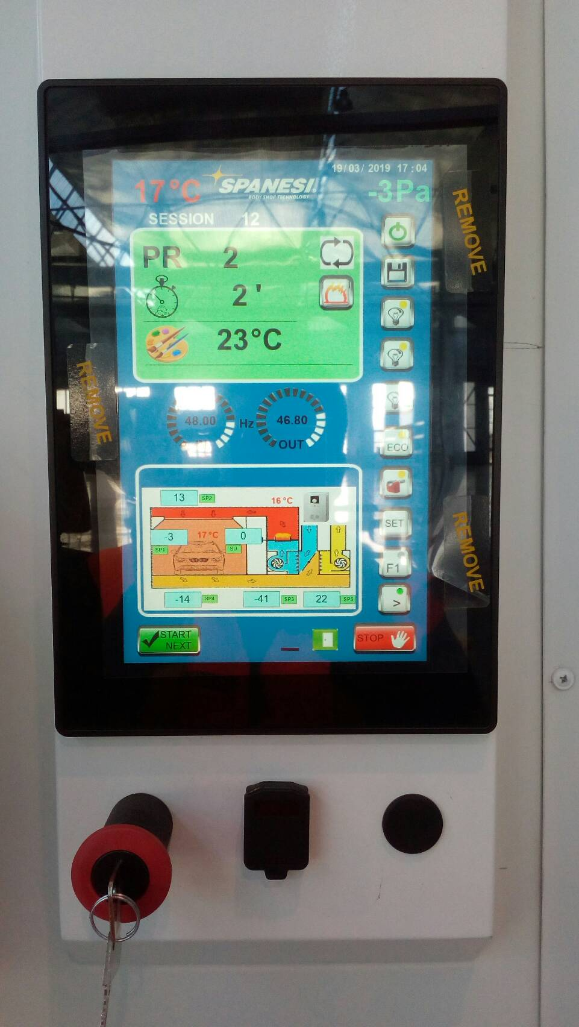
INSTALATIONS
Railway
BMI (Valladolid)
Control panel Evolutto.

Slide 19
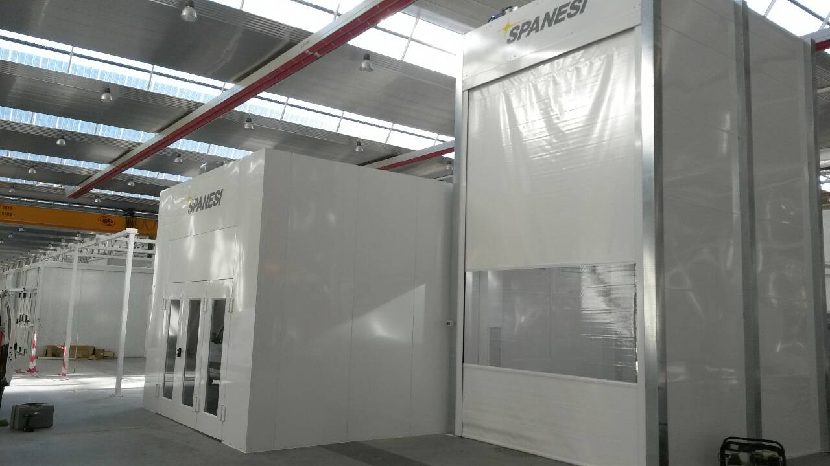
INSTALATIONS
Railway
ITK- RENFE (Valladolid)
Spray Booth for small pieces
Special Spray Booth.

Slide 20
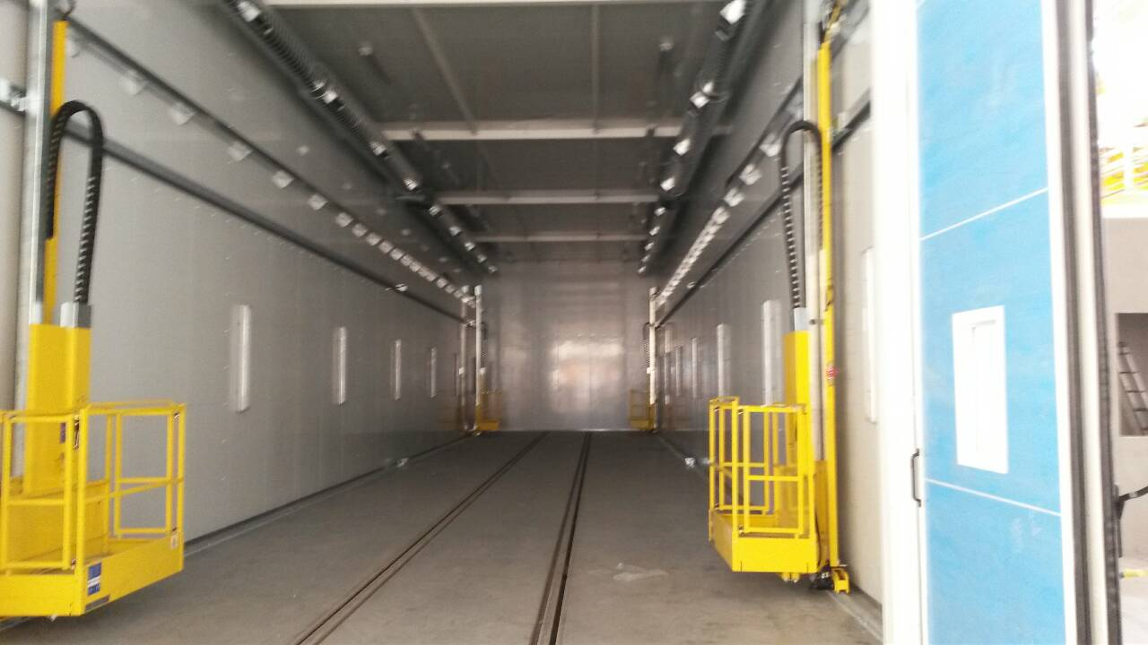
INSTALATIONS
Railway
ITK- RENFE (Valladolid)
Painters lifts.

Slide 21
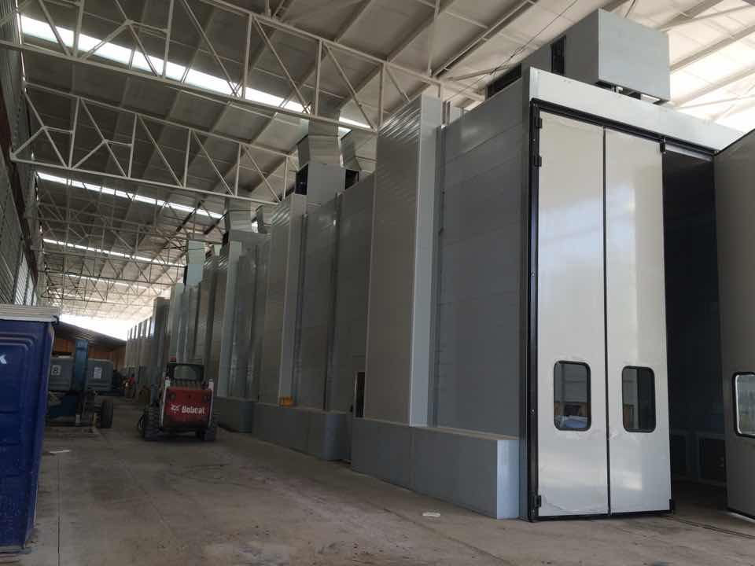
INSTALATIONS
Railway
TECNOVE- METRO CHILE
Spray Booth

Slide 22

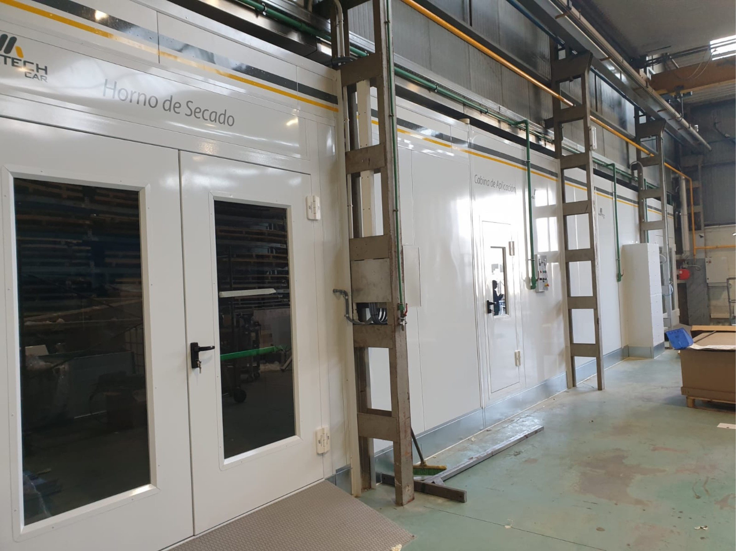
INSTALATIONS
Industry
GAMELSA (GRUPO TELEVES)
Instalation to Paint, prepair and drier special pieces

Slide 23
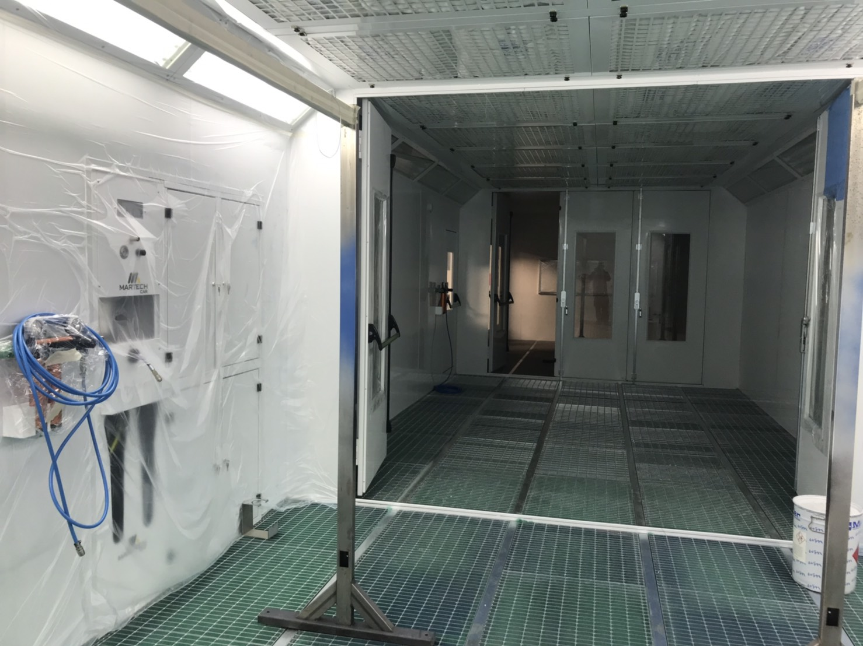
Industria
INSTALATIONS
GAMELSA (GRUPO TELEVES)
Instalation to special pieces
Spray Booth.

Slide 24
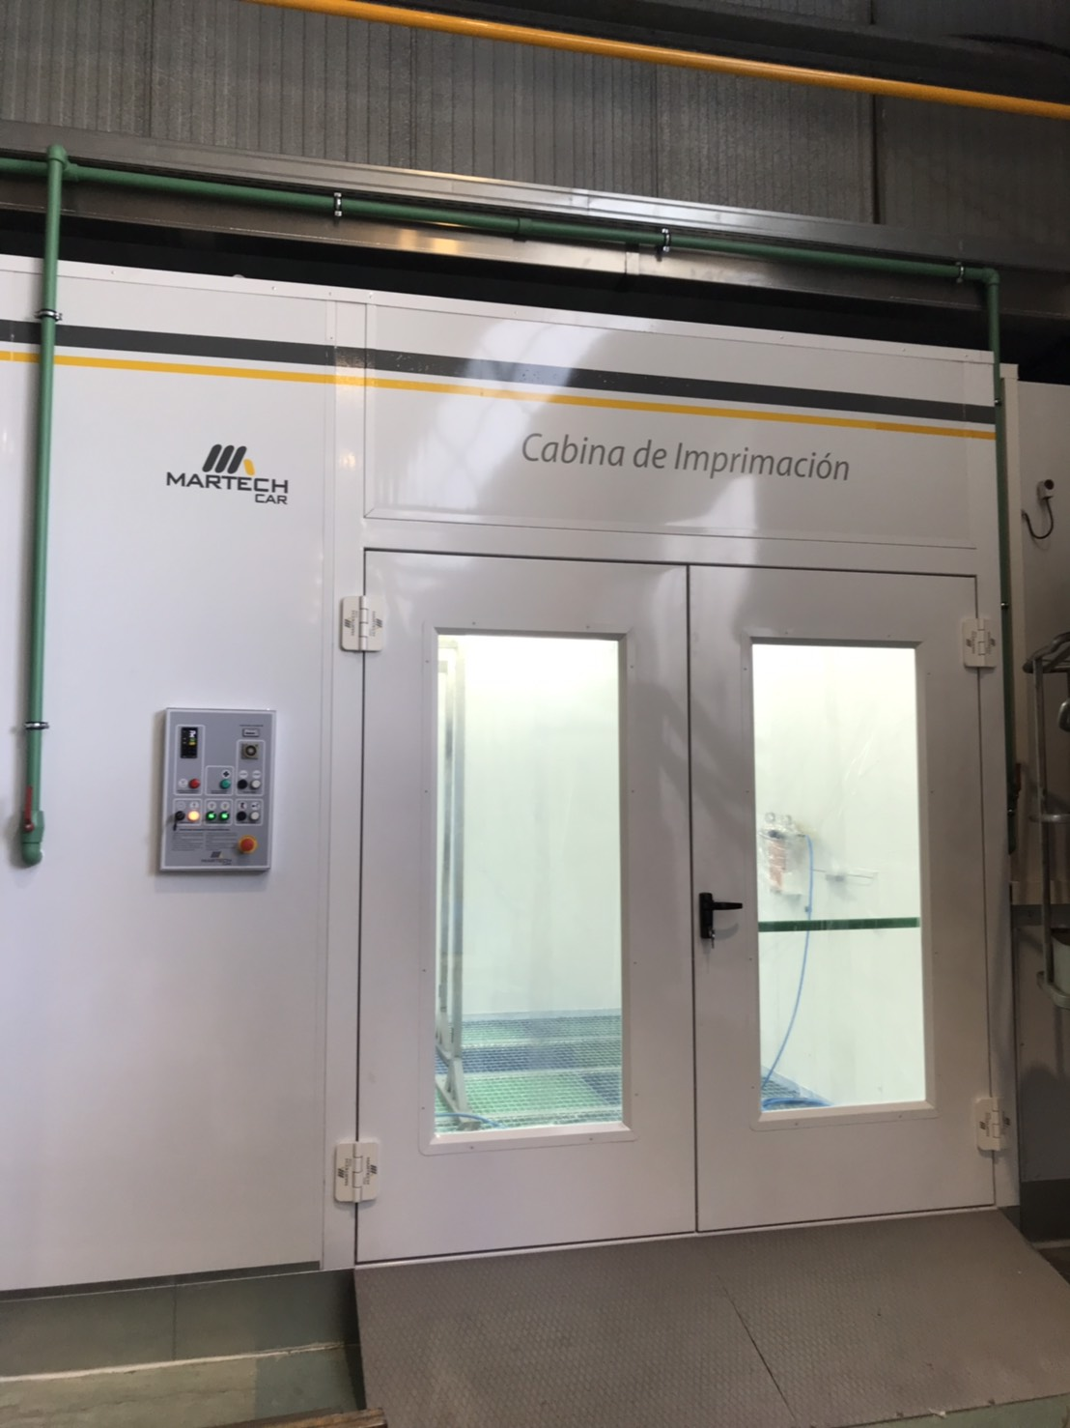
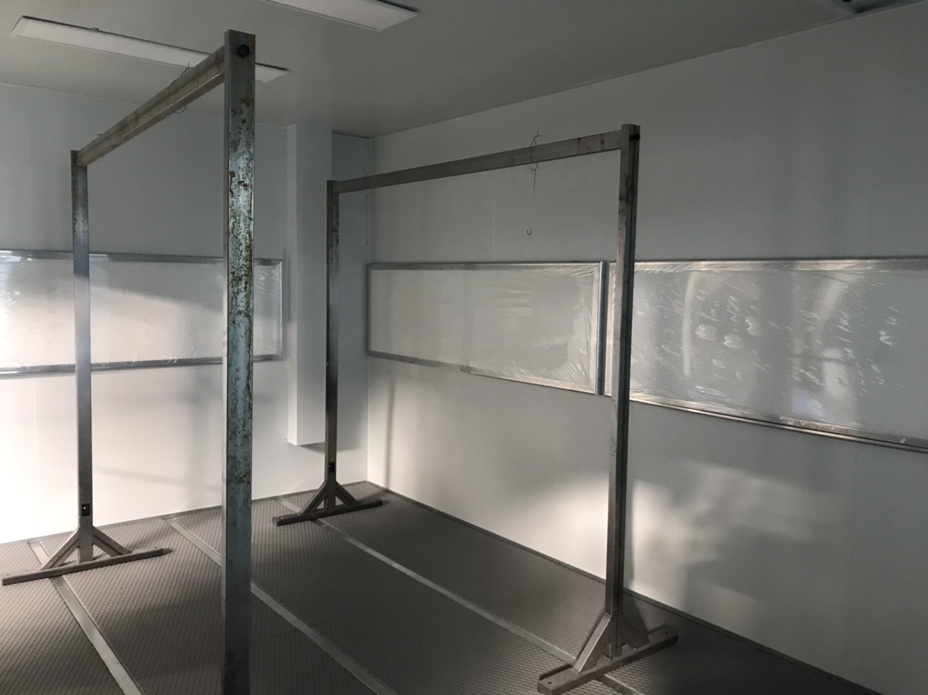
Industry
INSTALATIONS
GAMELSA (GRUPO TELEVES)
Instalation for special pieces
Spray Booth
Endotermic panels drier

Slide 25
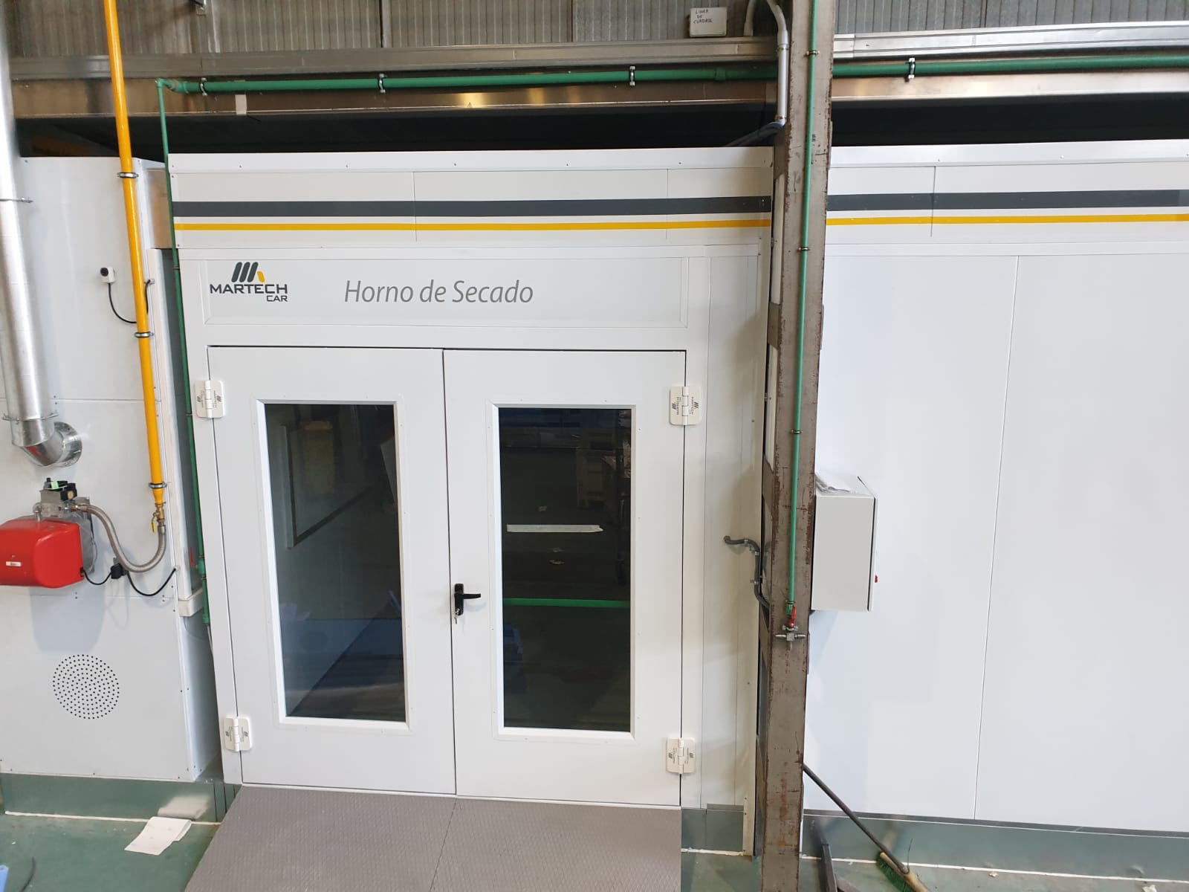
Industry
INSTALATIONS
GAMELSA (GRUPO TELEVES)
Instalation for special pieces
Driying oven

Slide 26

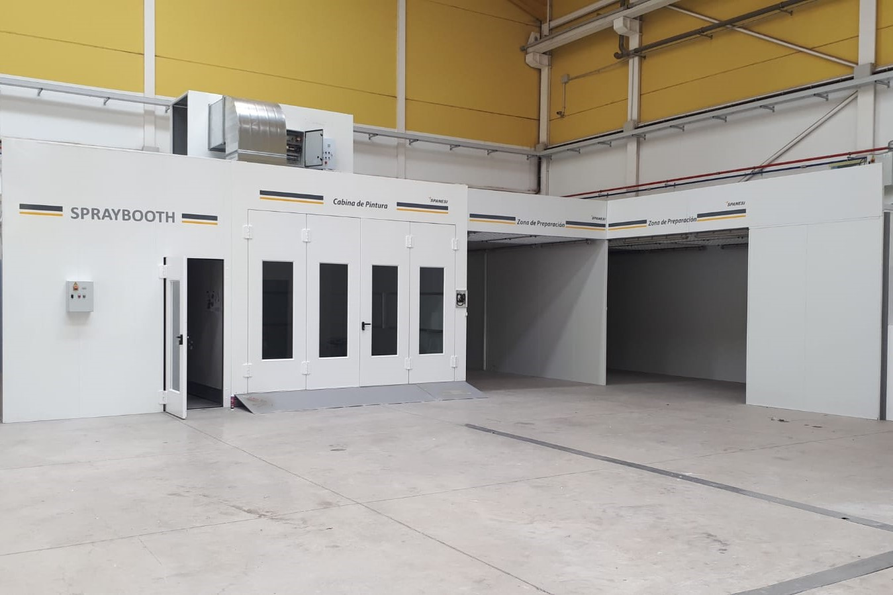
Aeronautic
INSTALATIONS
BINTER CANARIAS
Spray Booth.

Slide 27
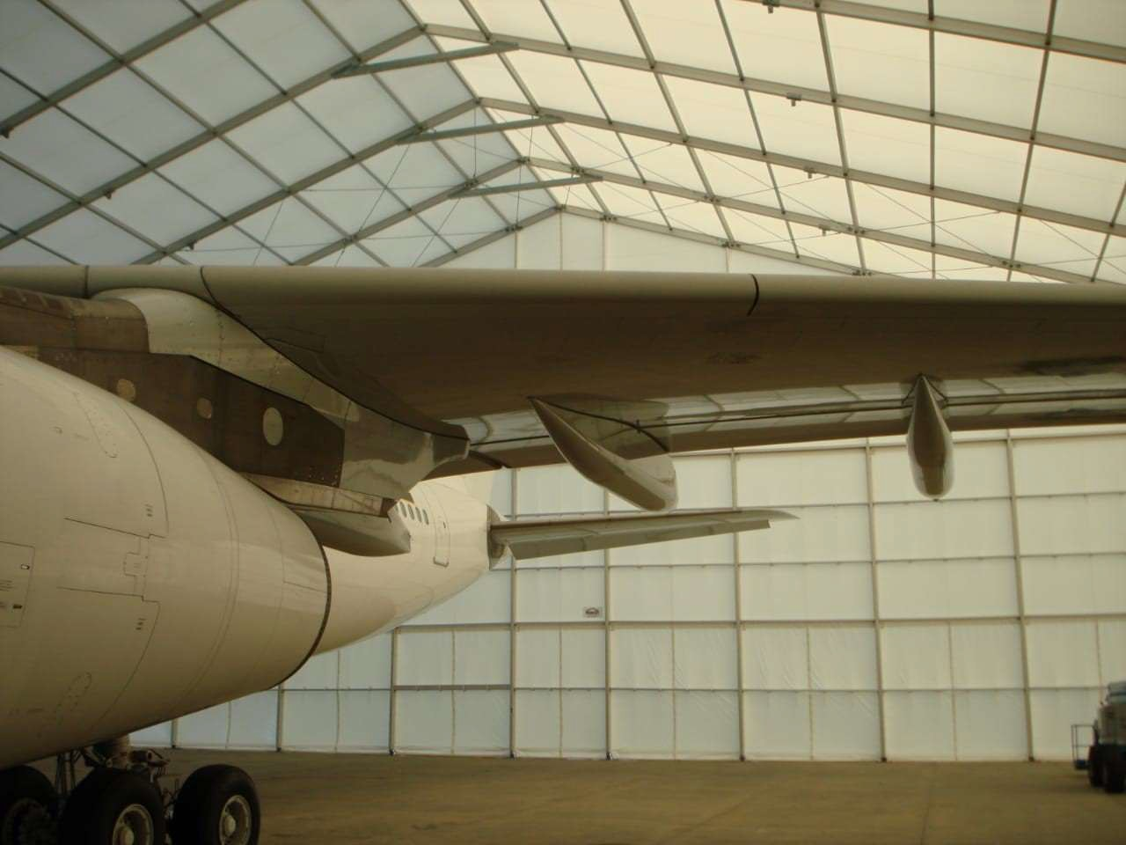
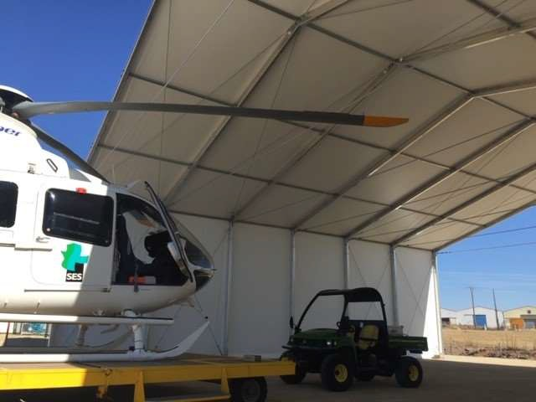
Aeronautic
INSTALATIONS
BABCOK (Extremadura)
Hangar to paint airplane

Slide 28
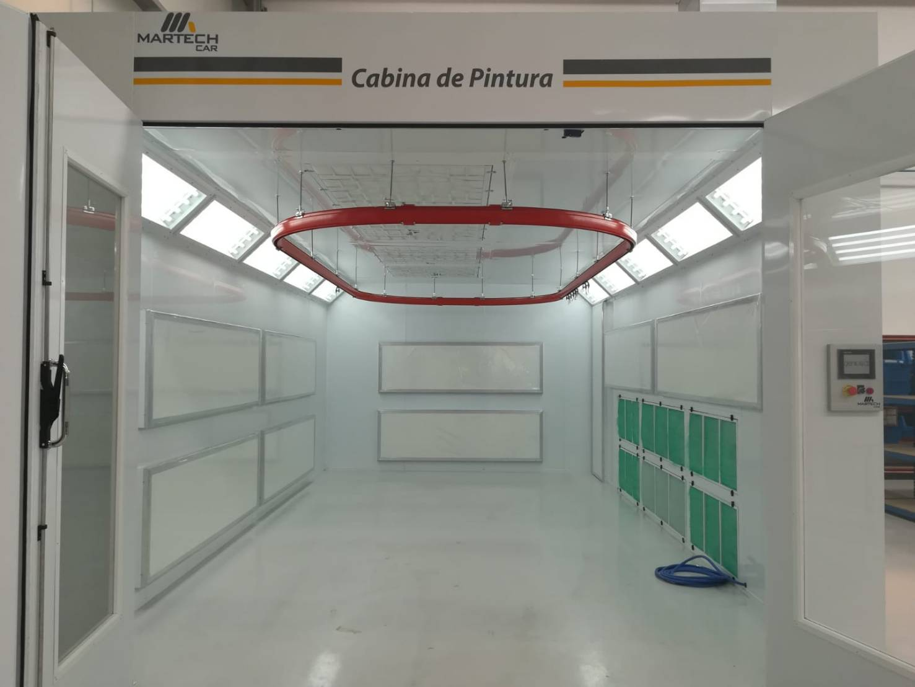
Industry
INSTALATIONS
LUXIN TEC
Spray Booth
Endothermic panels system.

Slide 29
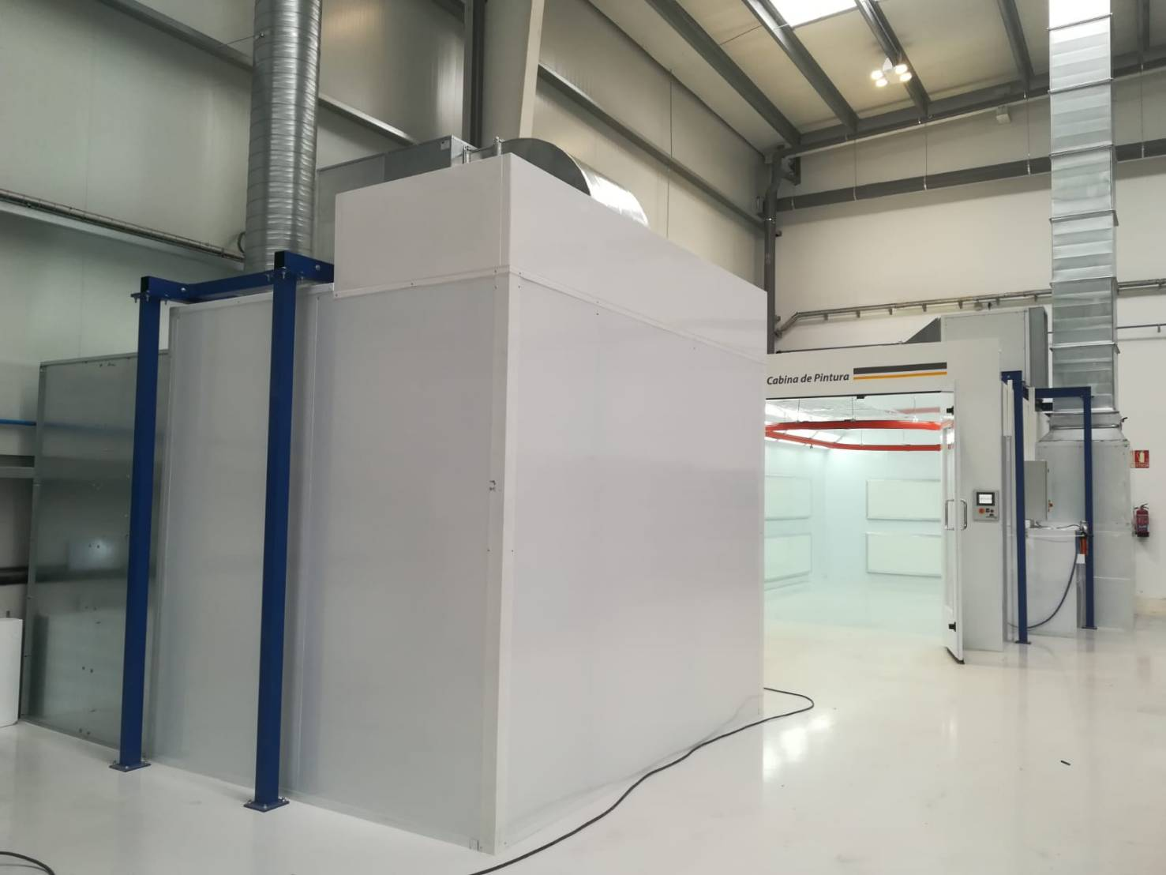
Industry
INSTALATIONS
LUXIN TEC
Spray Booth
Endothermic panels system.

Slide 30
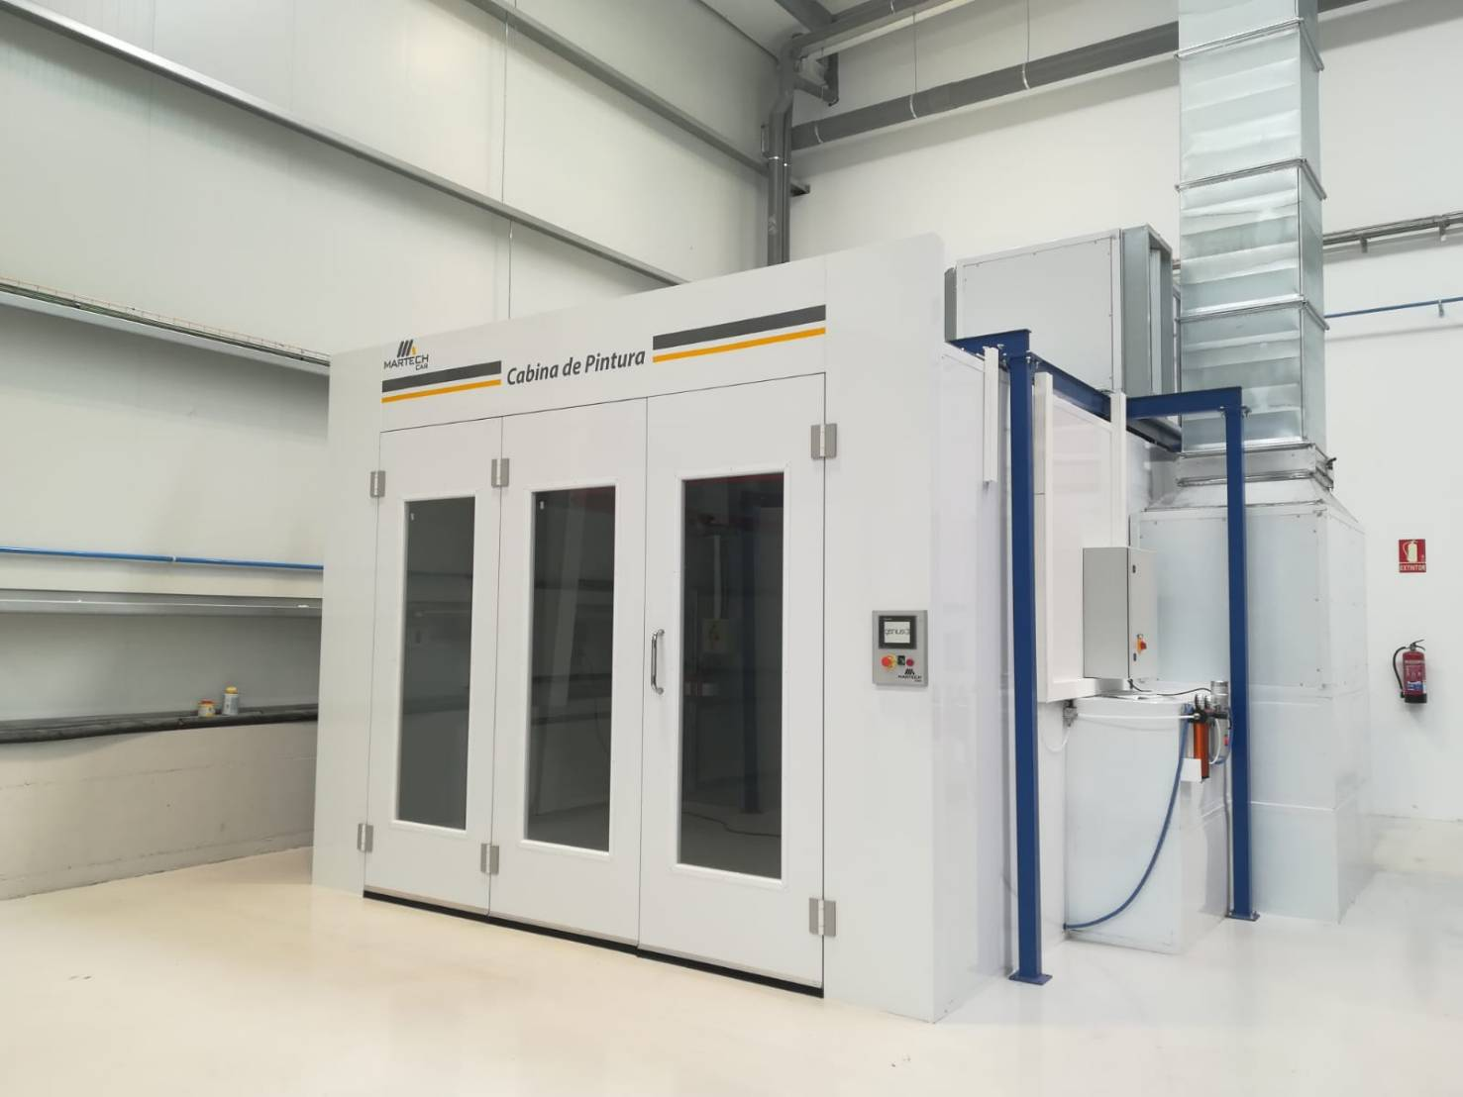
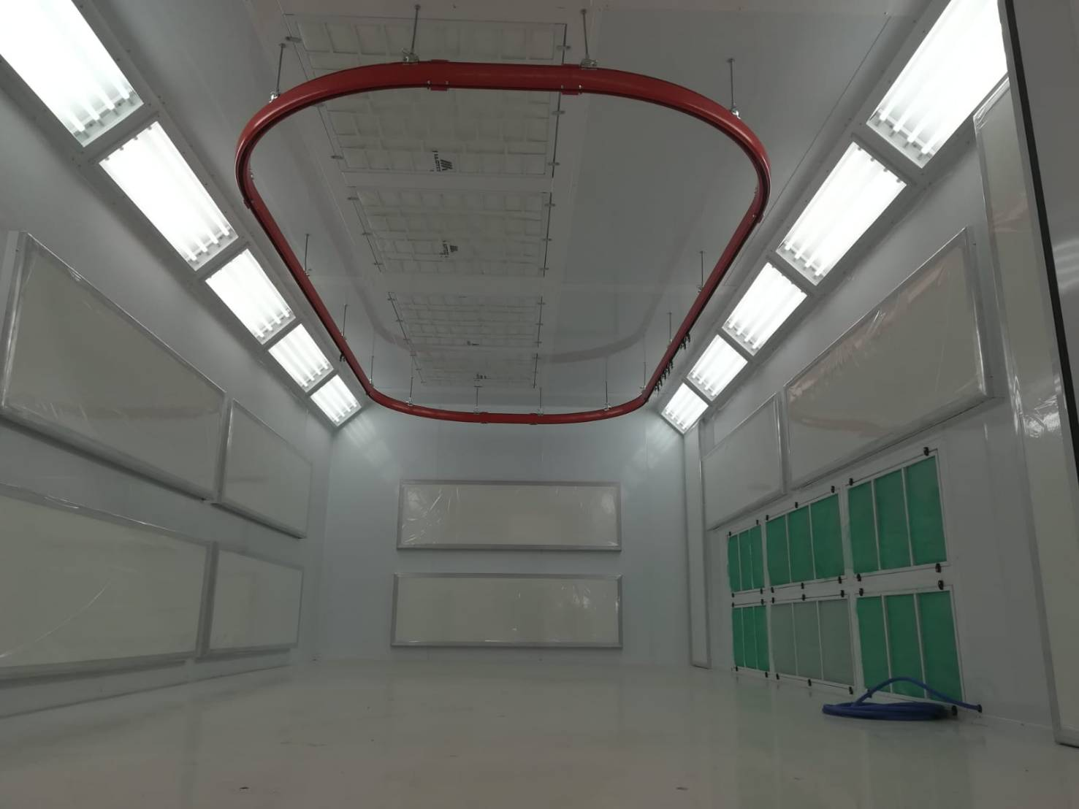
Industry
INSTALATIONS
LUXIN TEC
Spray Booth
Endothermic panels system.

Slide 31
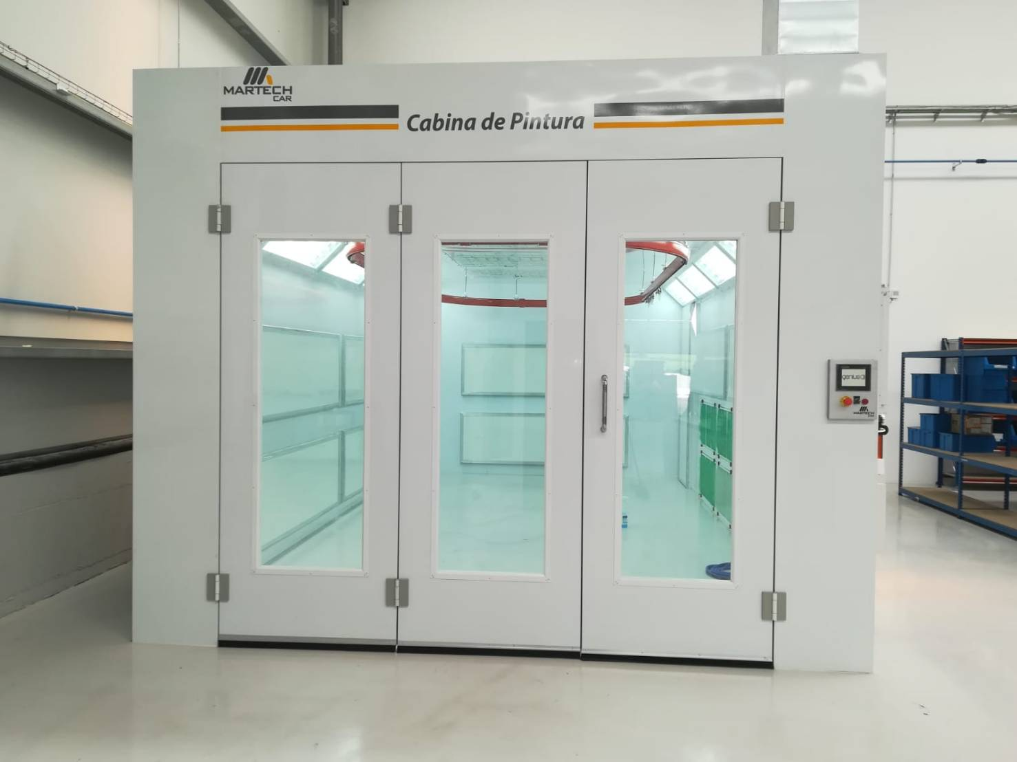
Industry
INSTALATIONS
LUXIN TEC
Spray Booth
Endothermic panels system.

Slide 32
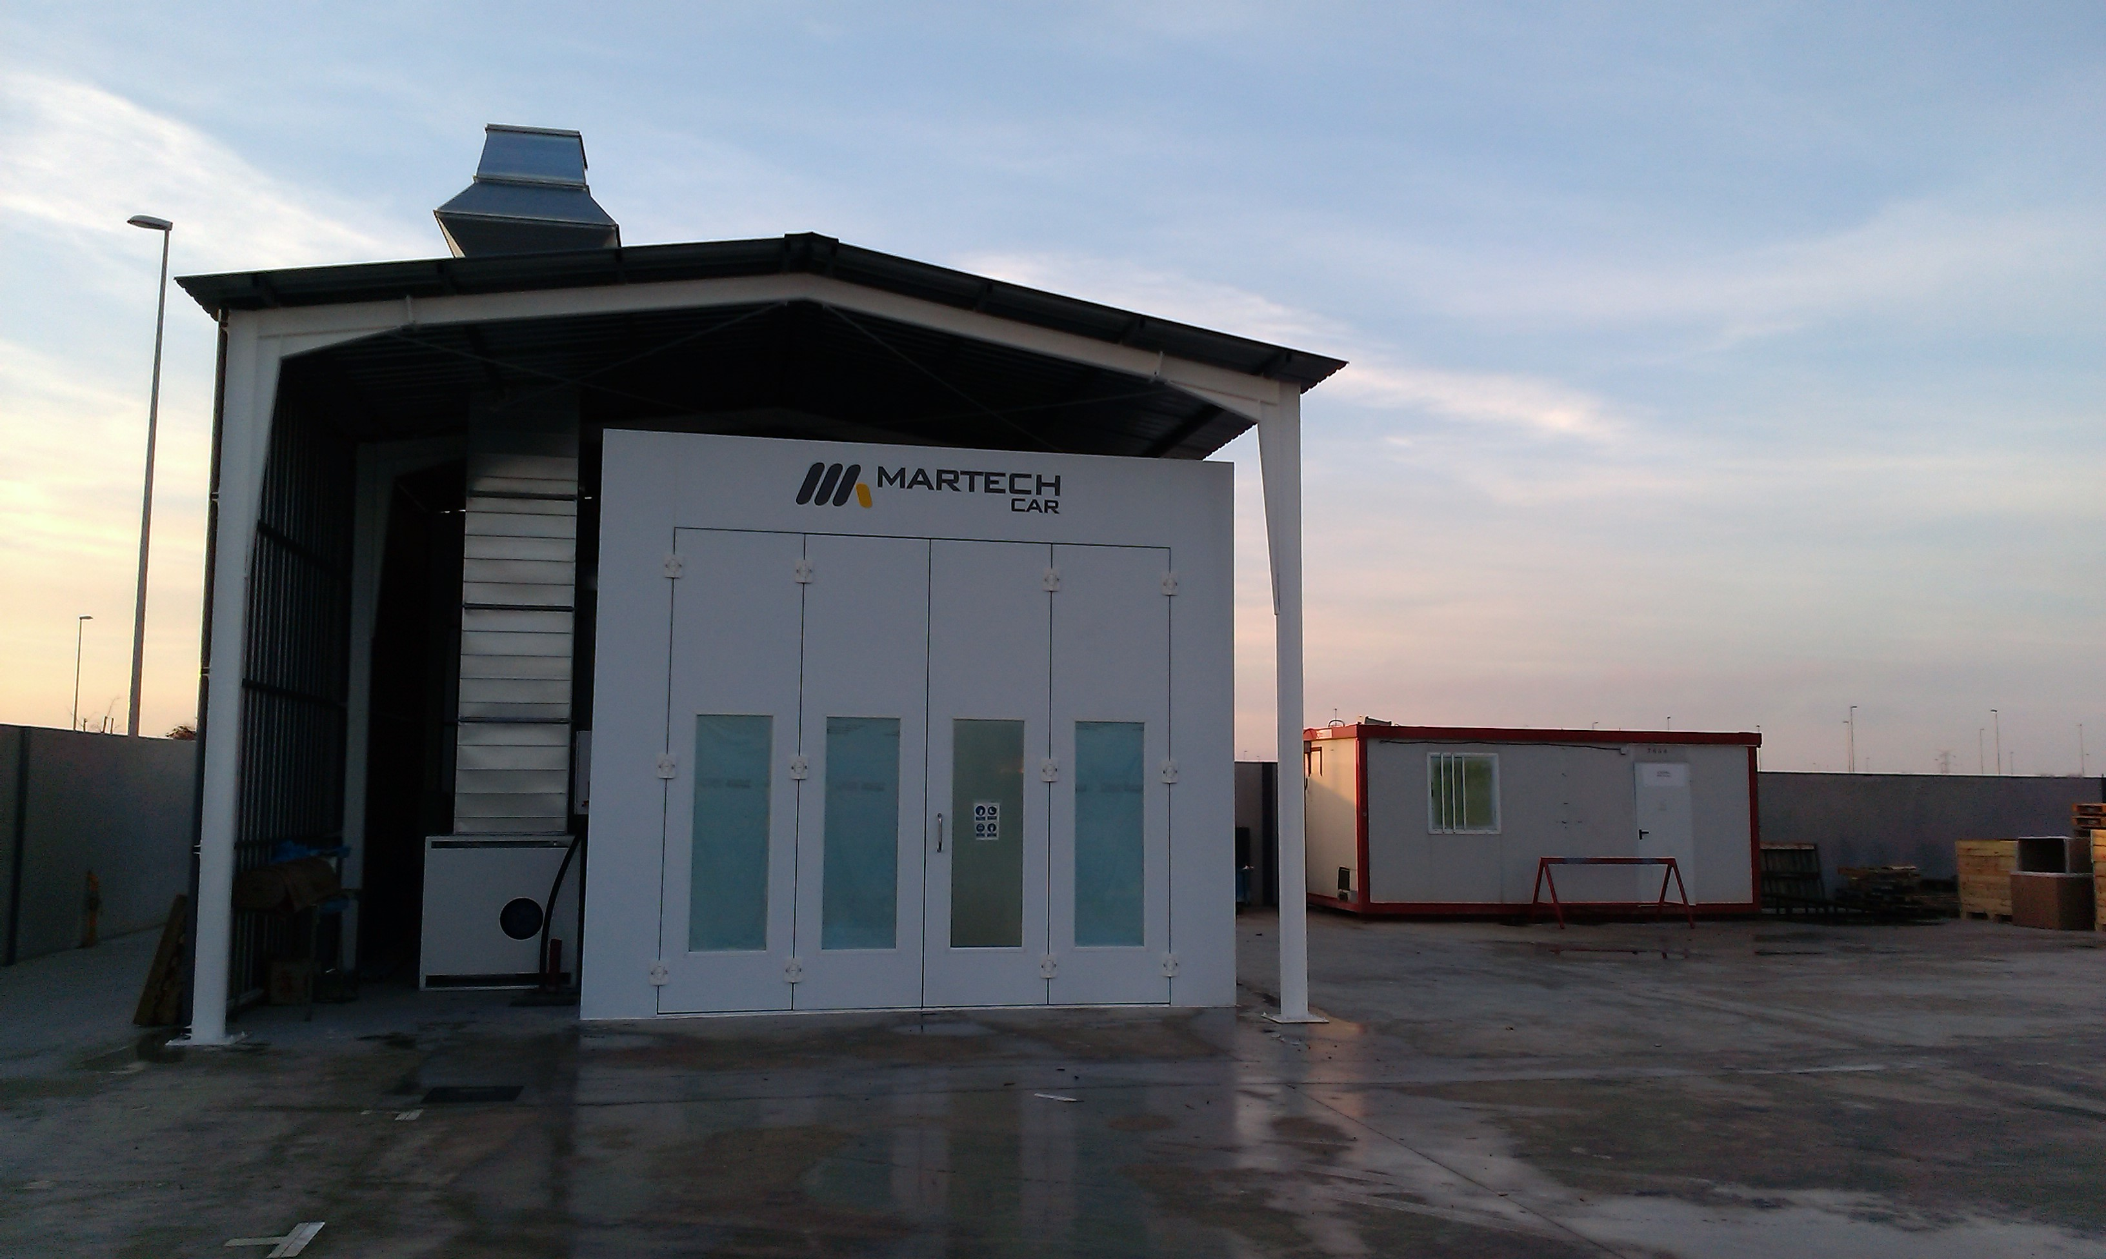
Industry
INSTALATIONS
EXPAL:
Outside Spray Booth

Slide 33
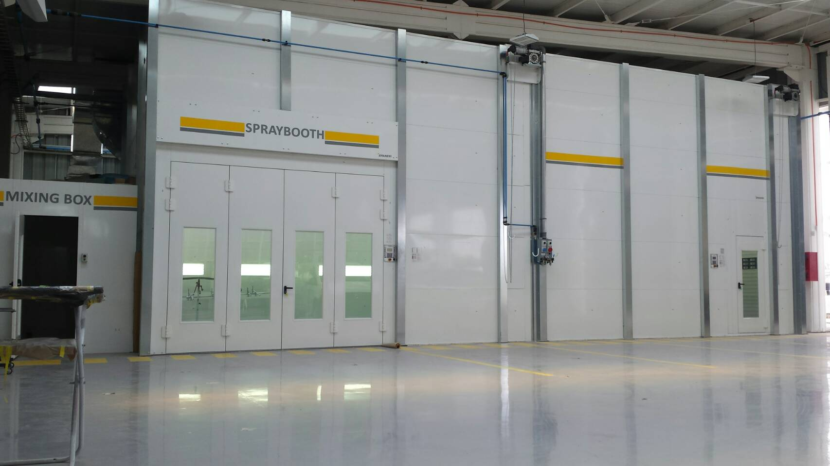
Industry
INSTALATIONS
KAUFMAN
Spray booth for big pieces.

Slide 34
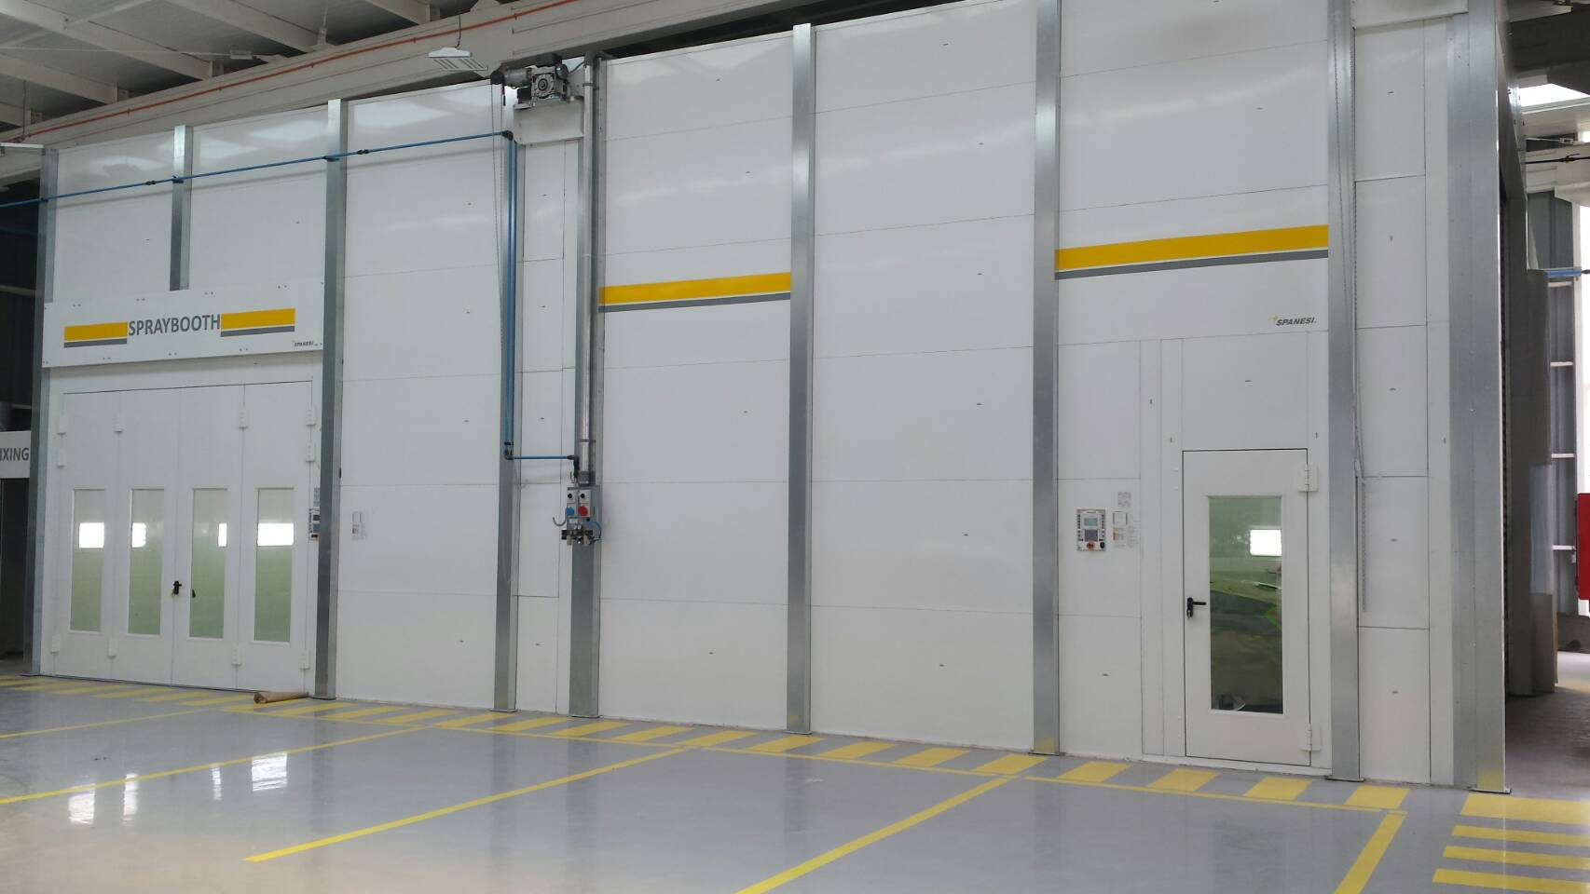
Industry
INSTALATIONS
KAUFMAN
Spray Booth for big pieces

Slide 35
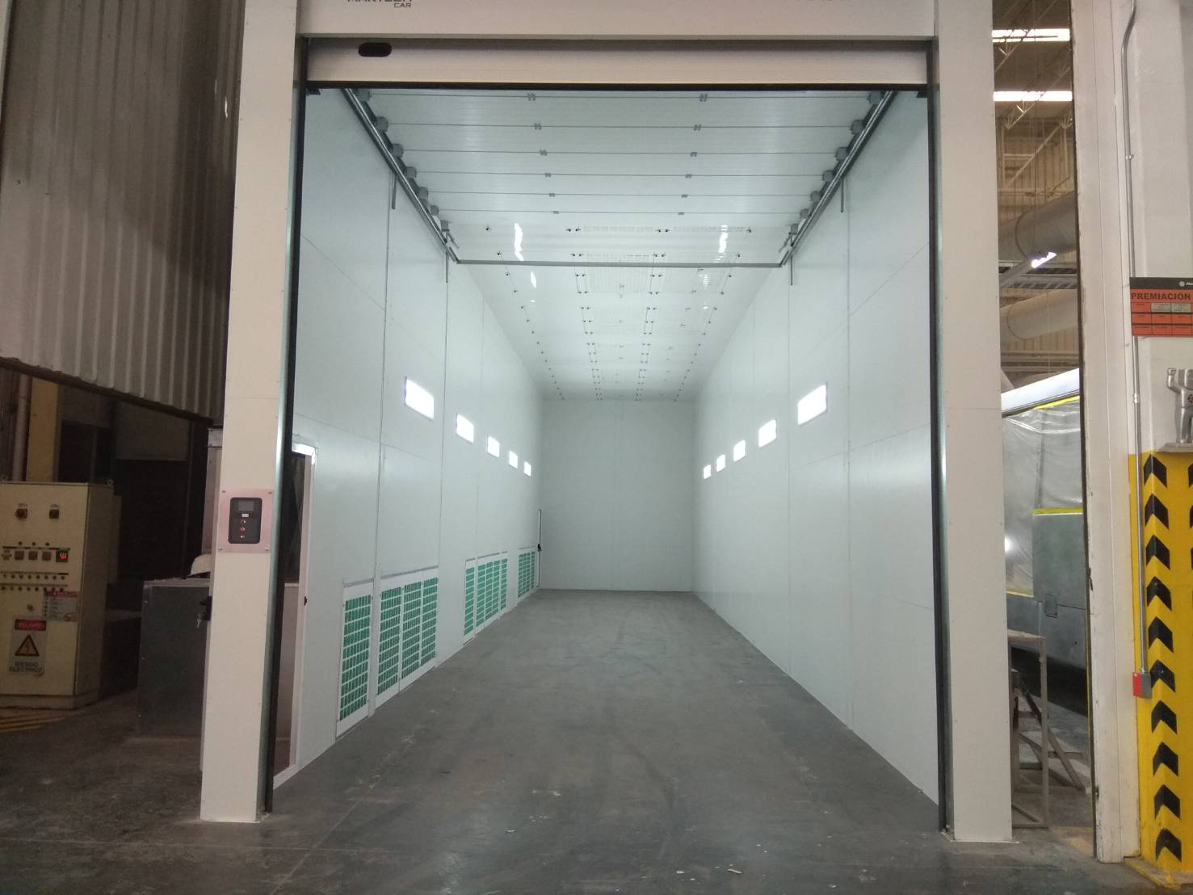
Industry
INSTALATIONS
TECNOCRASH
Spray Booth Semi Down-Draft.

Slide 36

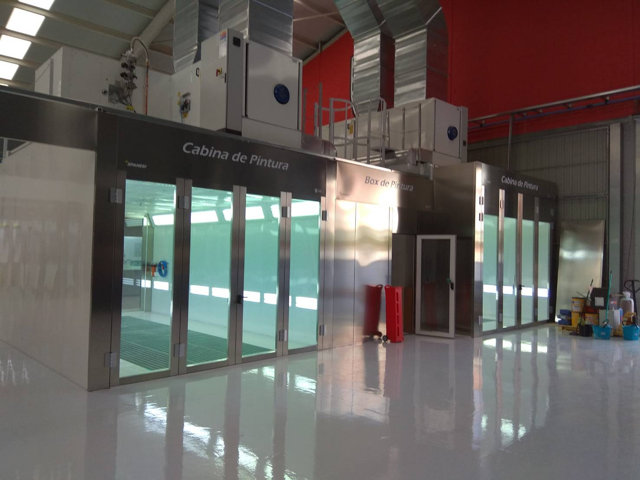
Automobile
INSTALATIONS
LEVER TOUCH
PDR center.
Spray Booth.

Slide 37
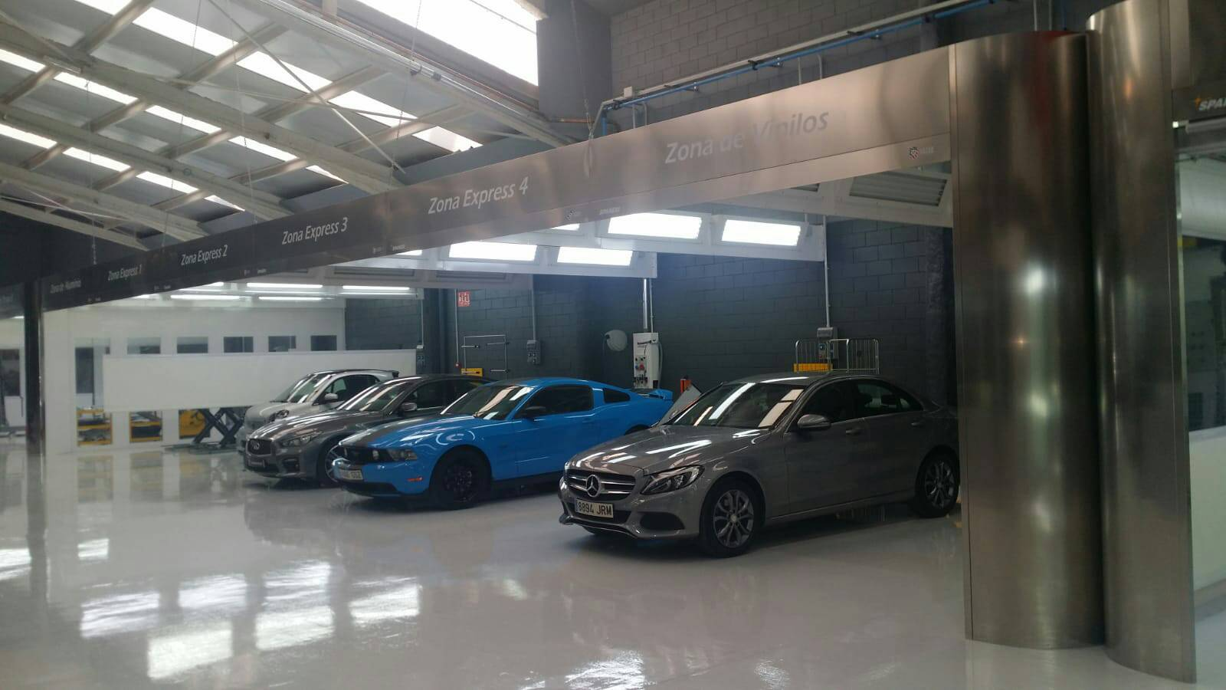
Automobile
INSTALATIONS
LEVER TOUCH (Barcelona)
PDR center
Preparation areas.

Slide 38
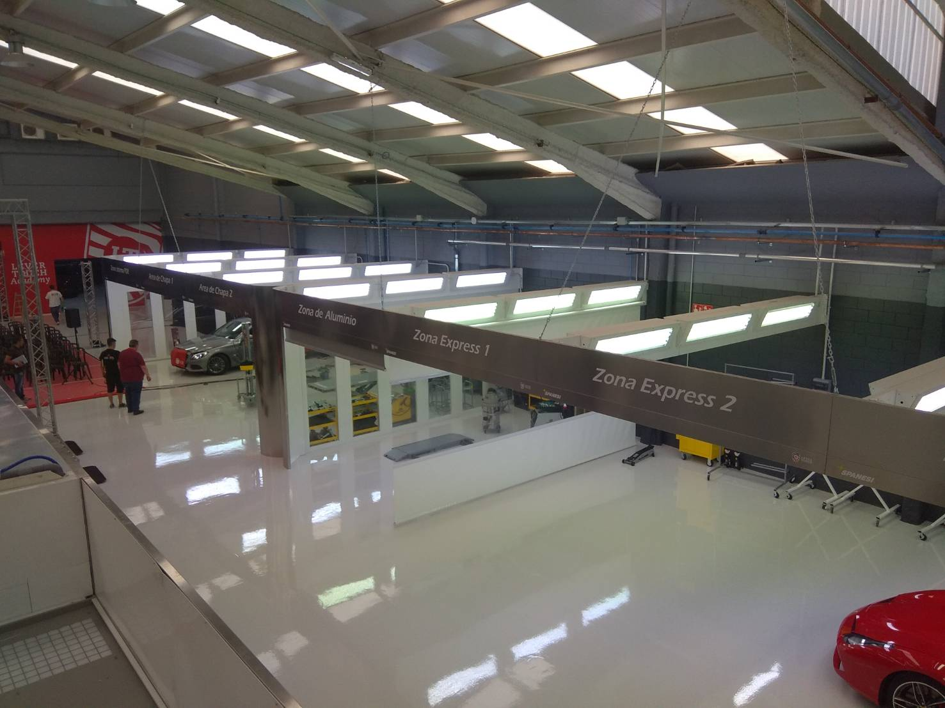
Automobile
INSTALATIONS
LEVER TOUCH (Barcelona)
PDR center.
Preparation areas.

Slide 39
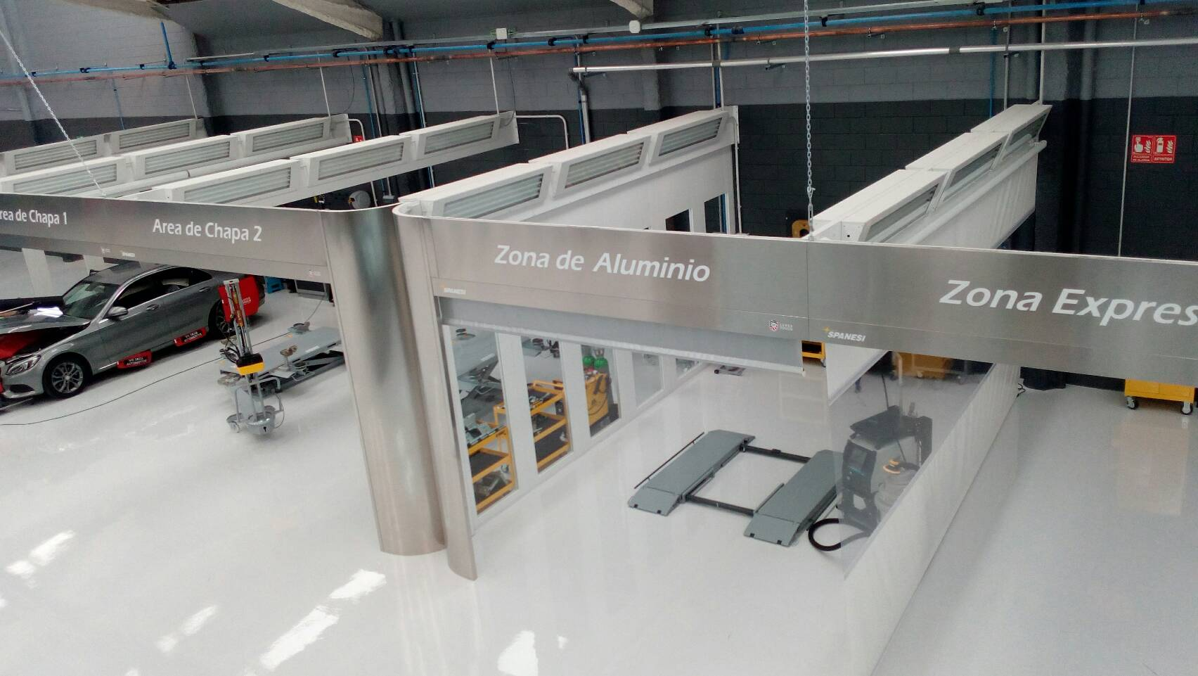
Automobile
INSTALATIONS
LEVER TOUCH (Barcelona)
PDR center
Aluminum prepration area.

Slide 40
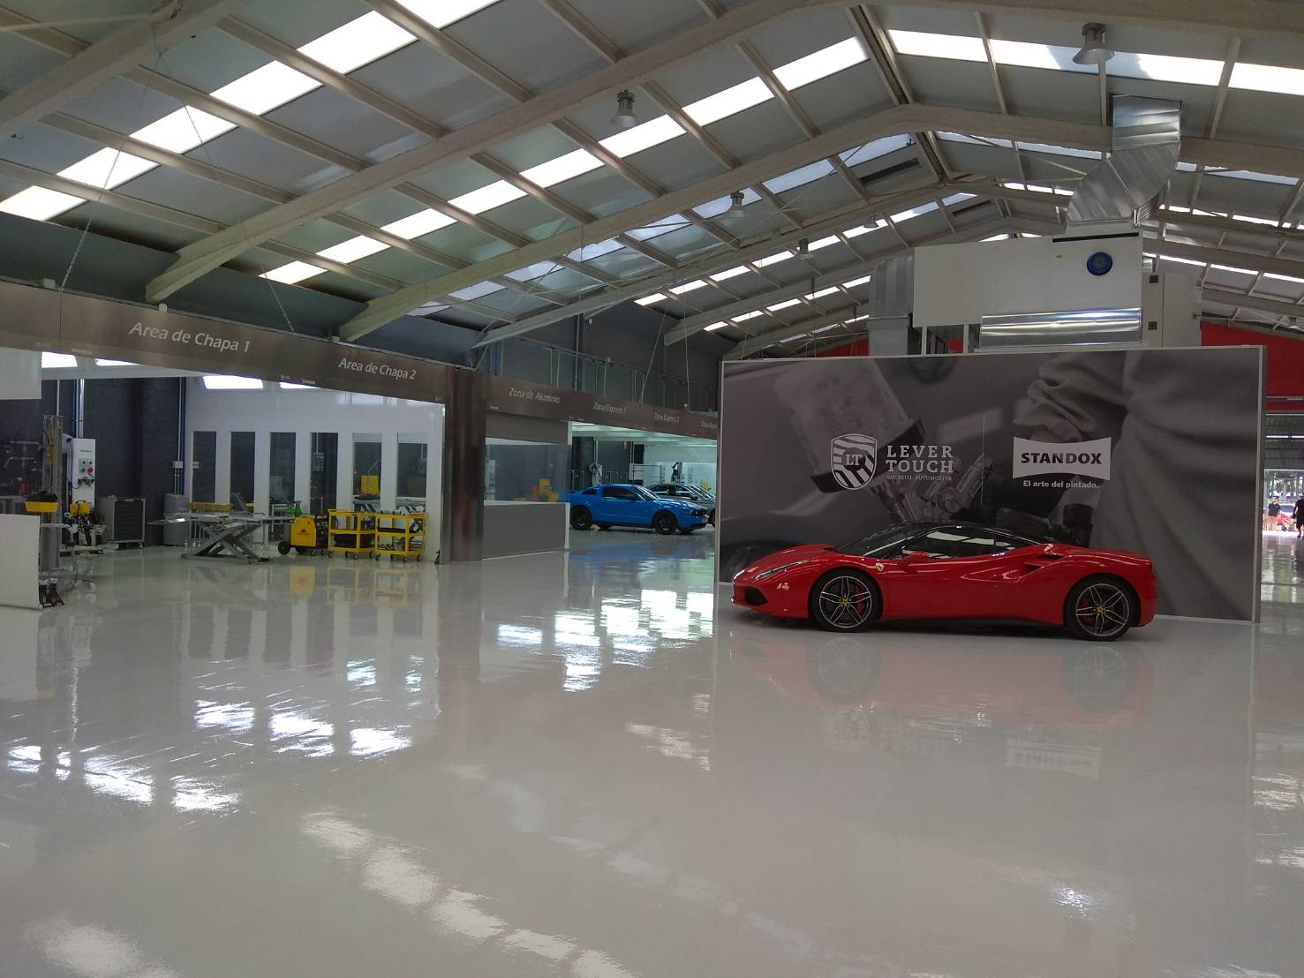
Automobile
INSTALATIONS
LEVER TOUCH (Barcelona)
PDR center
Preparation areas.

Slide 41

Automobile
INSTALATIONS
CESVIMAP:
Insurance Companies Institute
Spray Booth.
Endothermic panels system.

Slide 42

Automobile
INSTALATIONS
FASA PALENCIA
Renault Factory special spray booth.

Slide 43

Automobile
INSTALATIONS
FASA PALENCIA
Renault Factory special spray booth.

Slide 44

INSTALATIONS
Automobile
GRUPO TOQUERO:
Rent a Car l.ogistic center

Slide 45
Parque Empresarial Campollano Calle C, Nº 50,
02007, Albacete –Spain
Tel: (+34) 967 520002
martechcorporation@martechcorporation.com
www.martechcorporation.com

